Slide 1

The Natural History of the Oaks Bottom Wildlife Refuge
Sellwood Community House Science Class Program – Fall 2019
John Marshall
503-913-1695
jl.marshall@comcast.net
Notes:
Hello, my name is John Marshall and I will be leading and facilitating The Natural History of the Oaks Bottom Wildlife Refuge class / workshop. I am a semi-retired Fish and Wildlife Biologist with the US Fish and Wildlife Service and Clean Water Act Inspector at the US Environmental Protection Agency. My goal in preparing these upcoming presentations is not to teach at you but rather to set the stage for interesting and enlightening discussions and to possibly even increase the potential for real world problem solving. This first set of slides will likely at first seem a bit out of context but please be patient, there is indeed a method behind the madness.

Slide 2


Slide 3


Slide 4


Slide 5


Slide 6


Slide 7


Slide 8


Slide 9


Slide 10
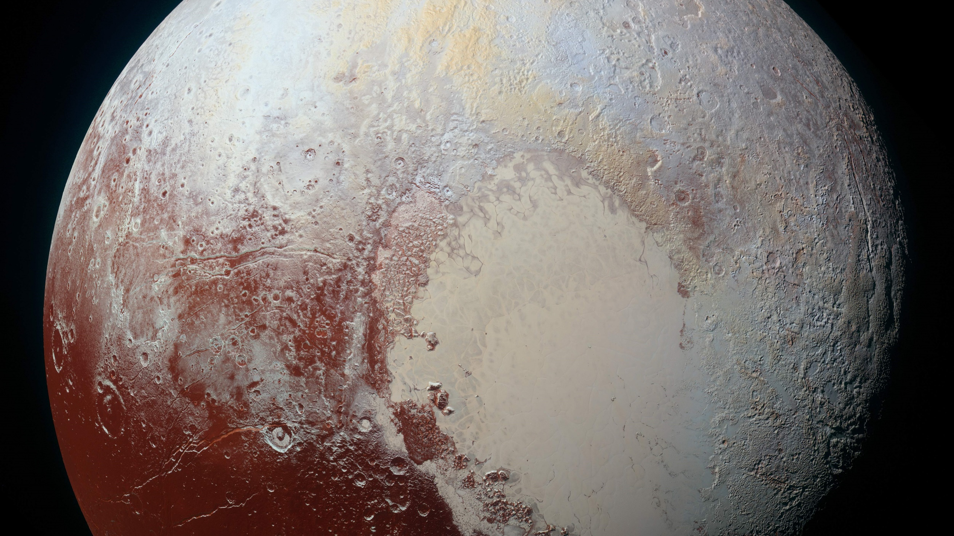

Slide 11
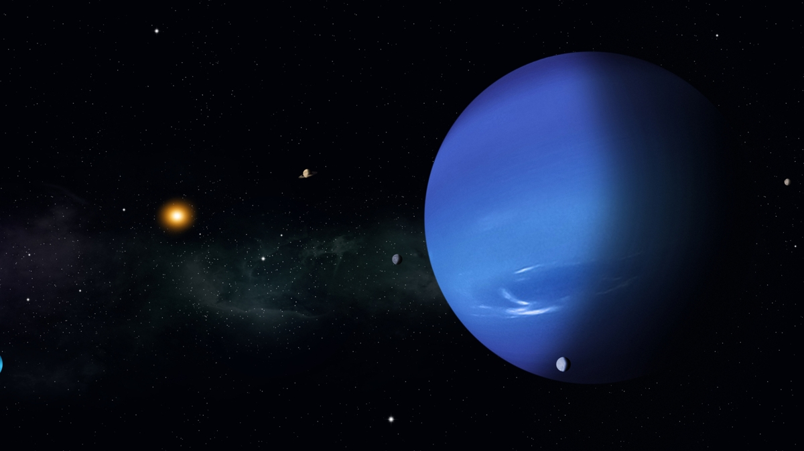

Slide 12


Slide 13
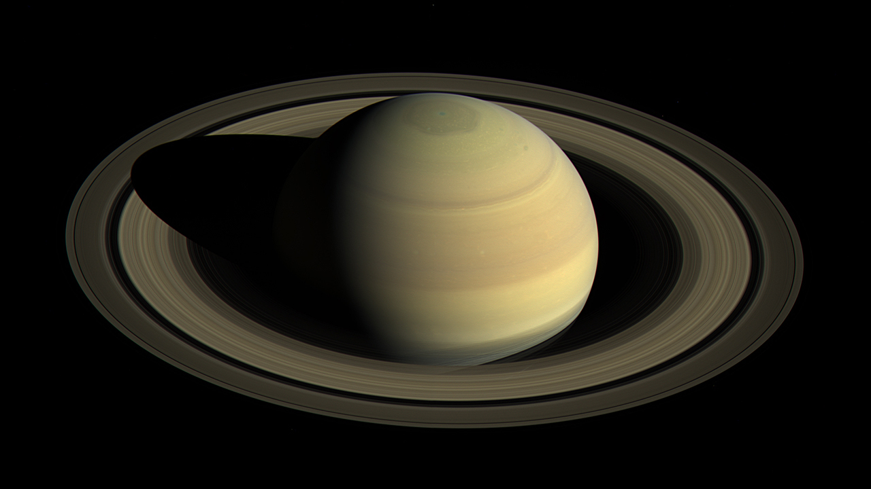

Slide 14


Slide 15
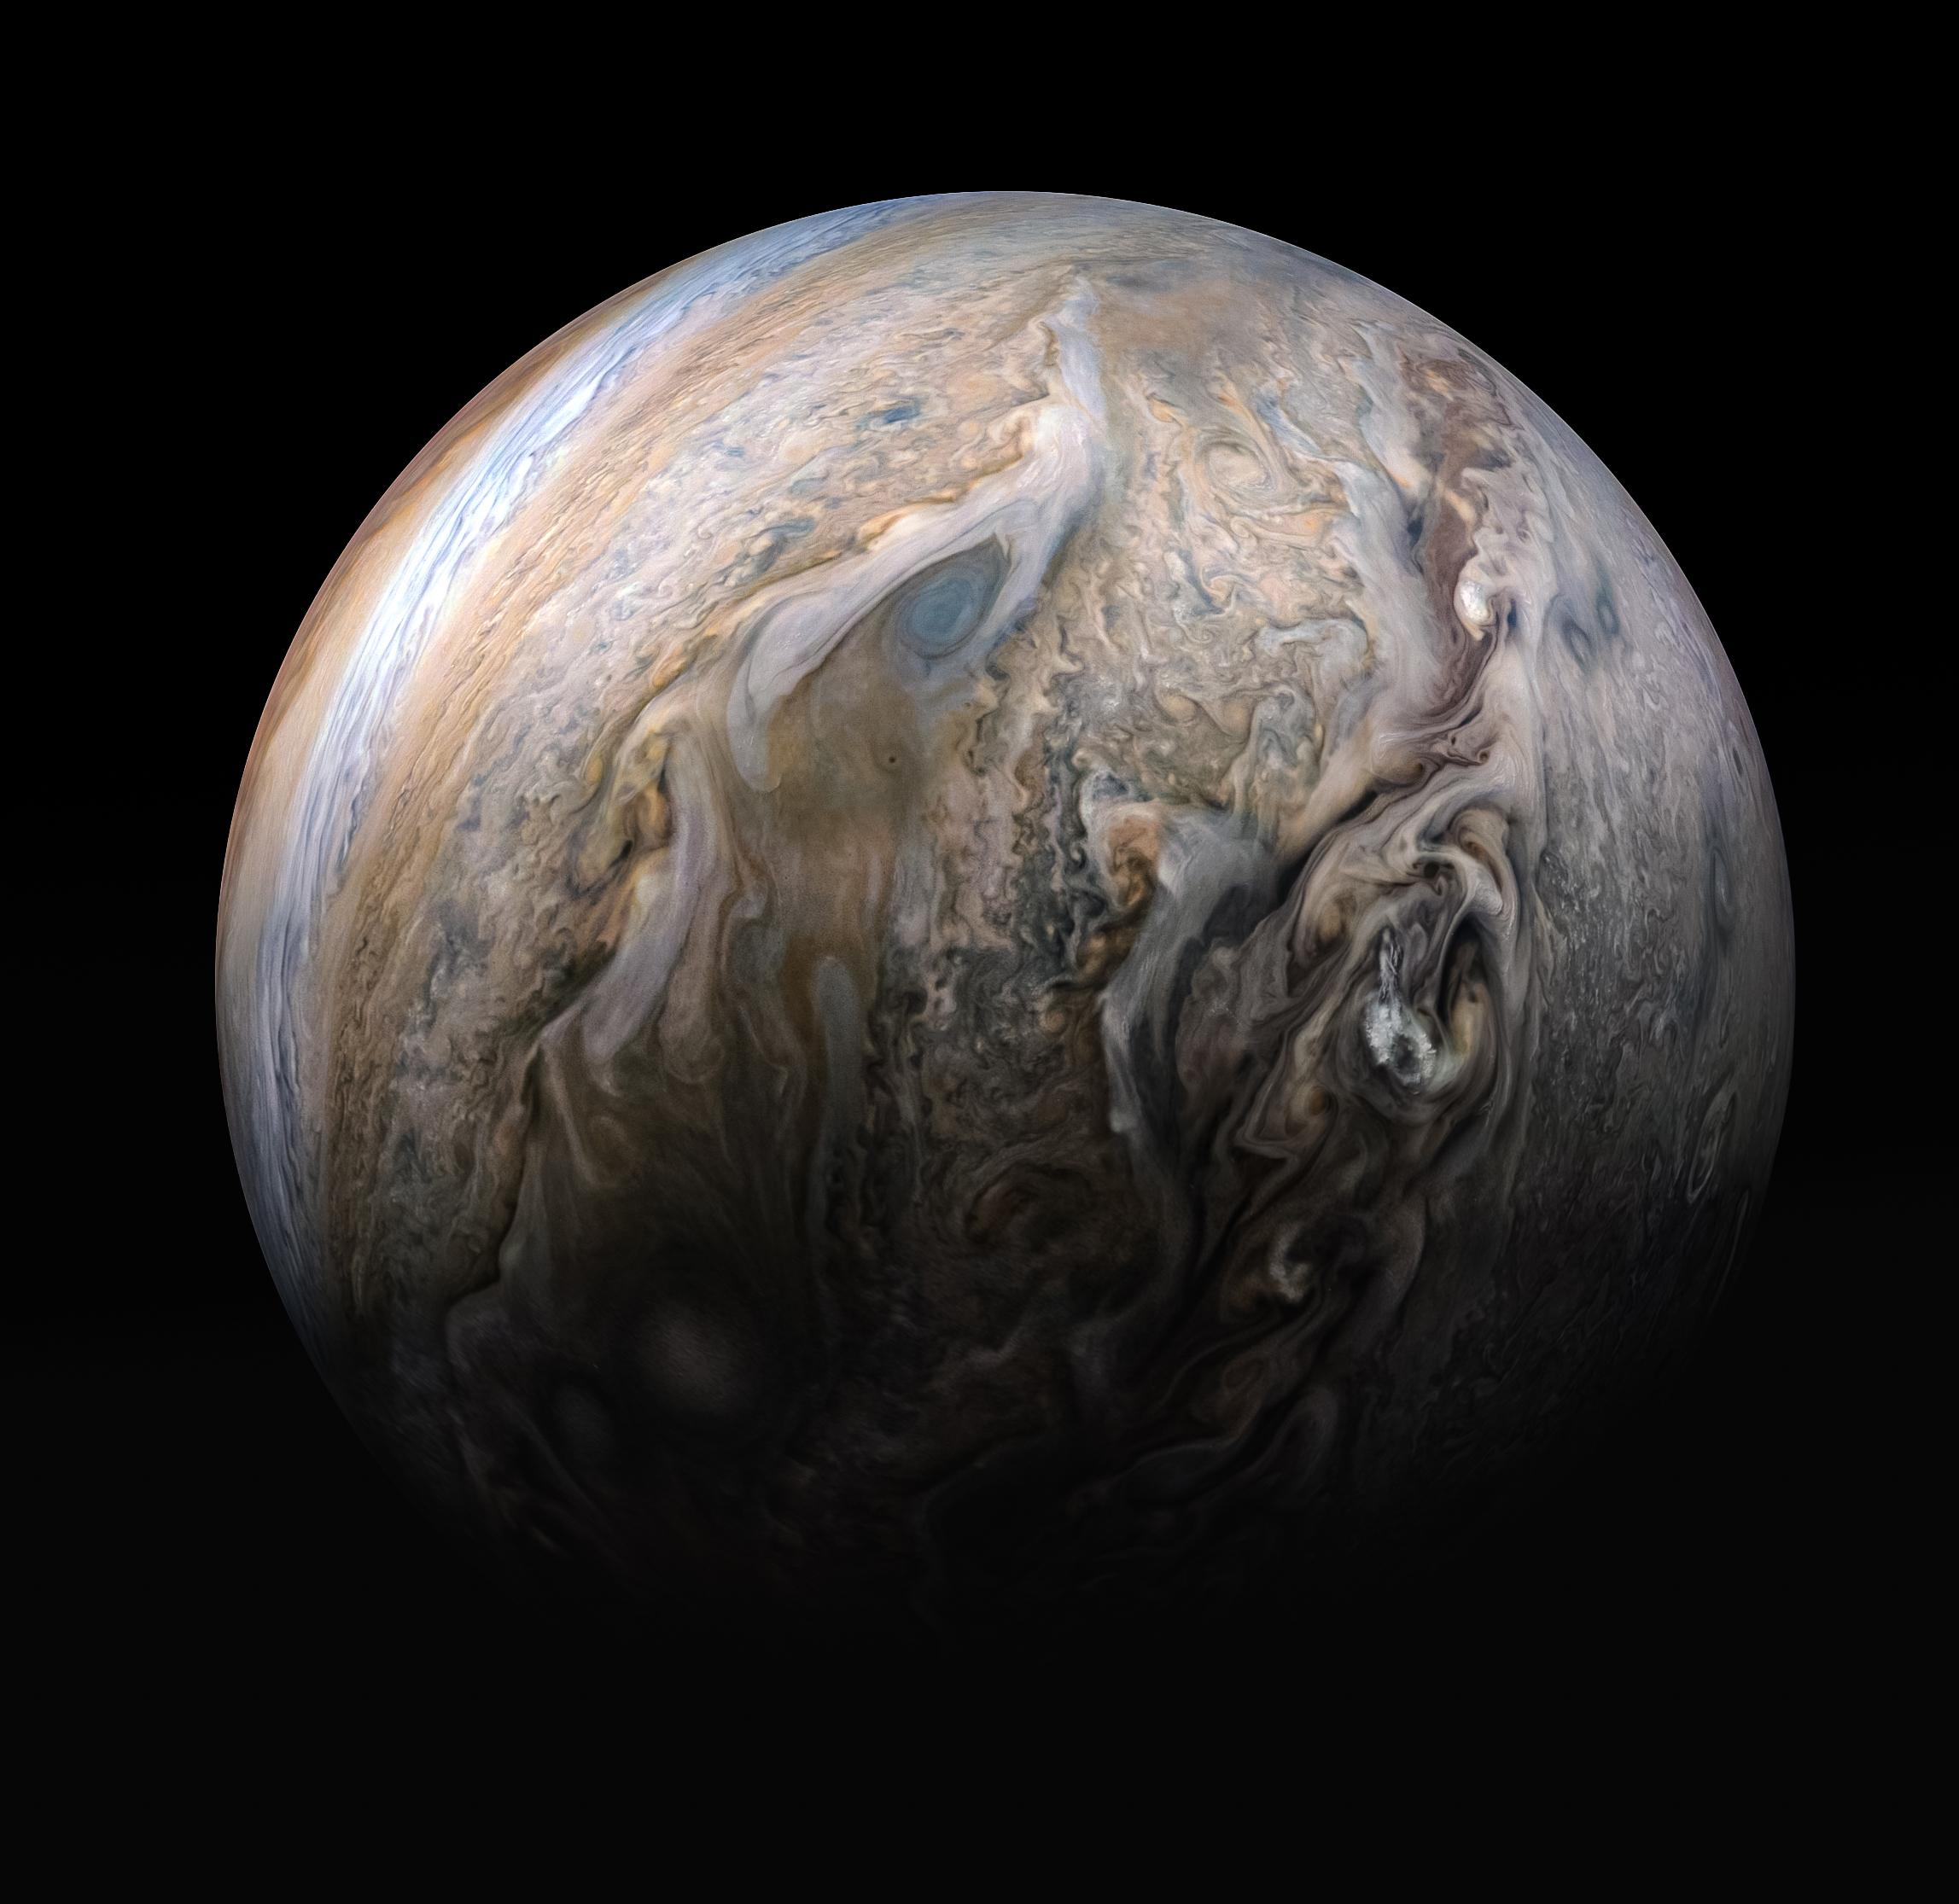

Slide 16
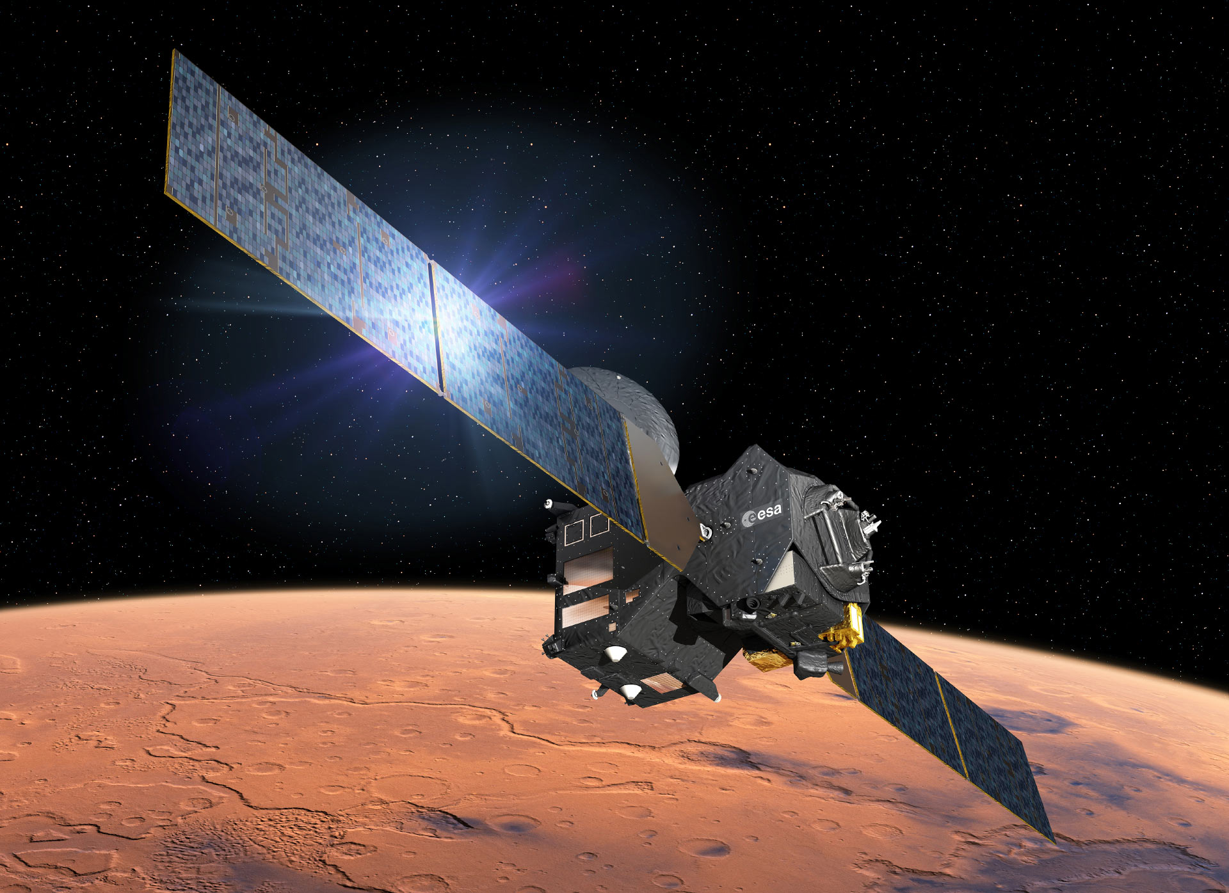

Slide 17
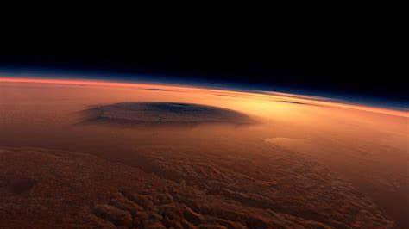

Slide 18
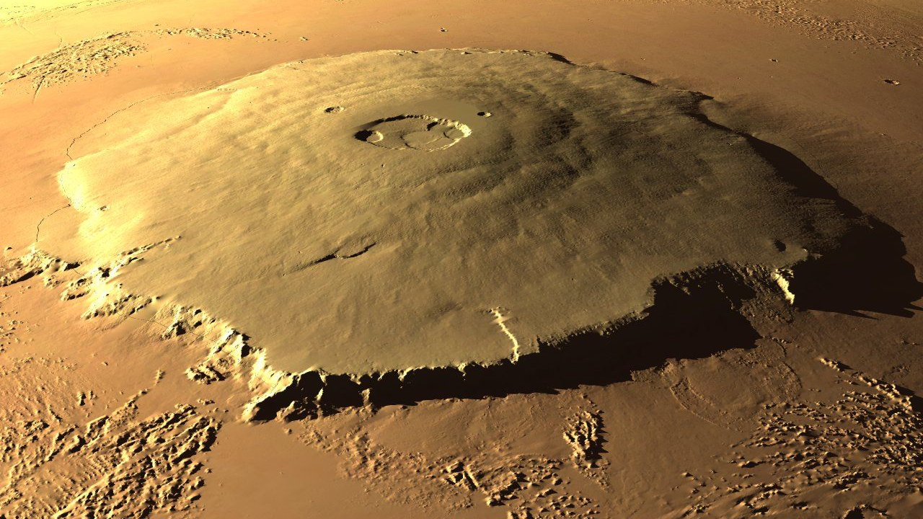

Slide 19
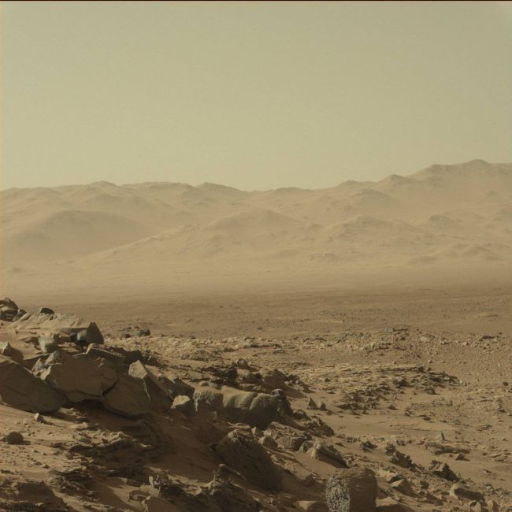

Slide 20
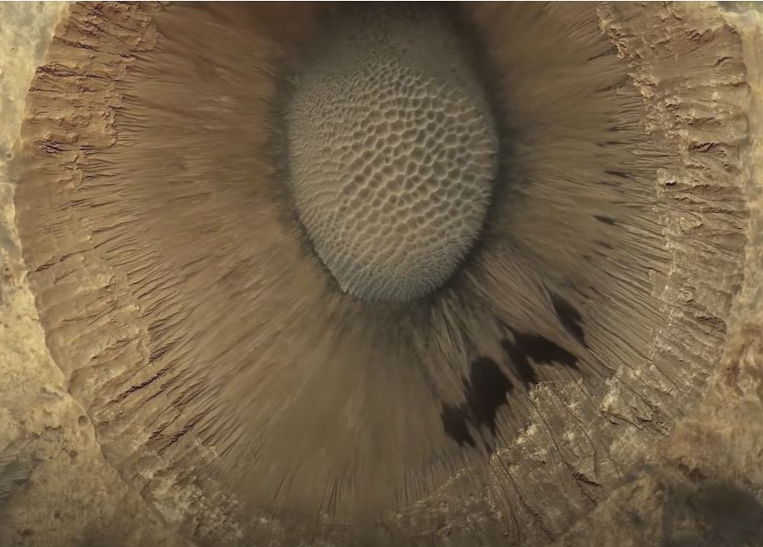

Slide 21
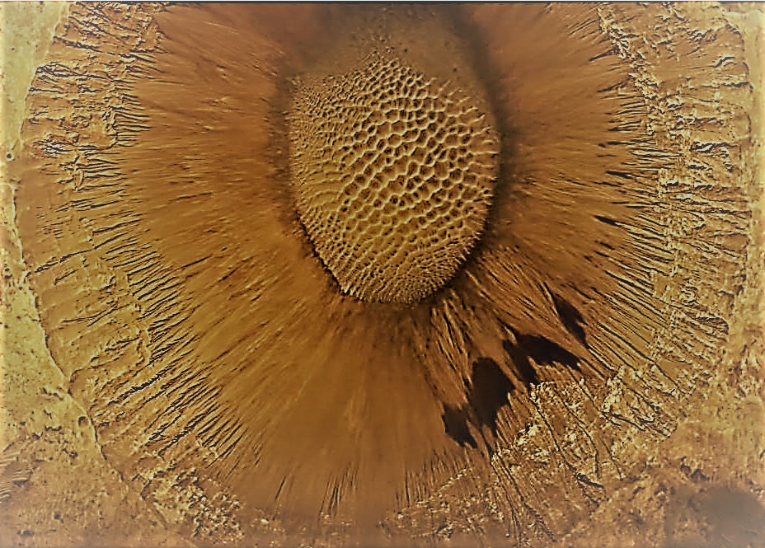

Slide 22

Moon Horizon

Slide 23


Slide 24
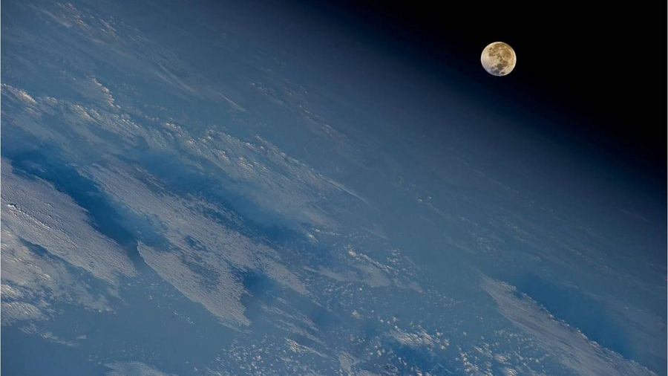

Slide 25
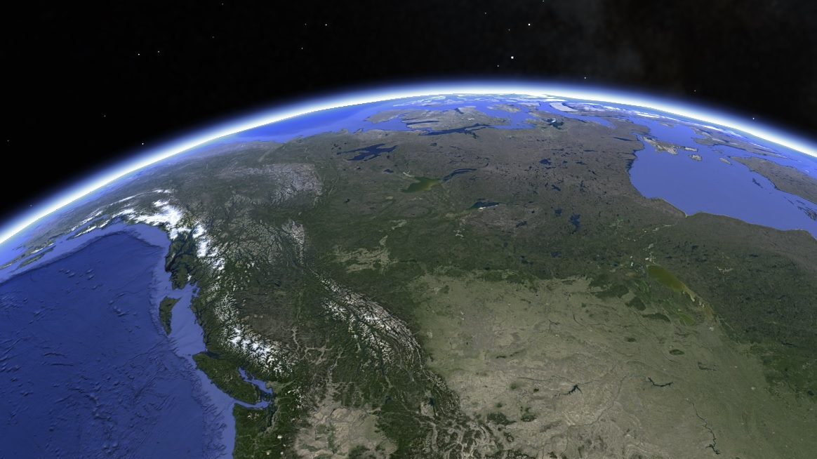

Slide 26
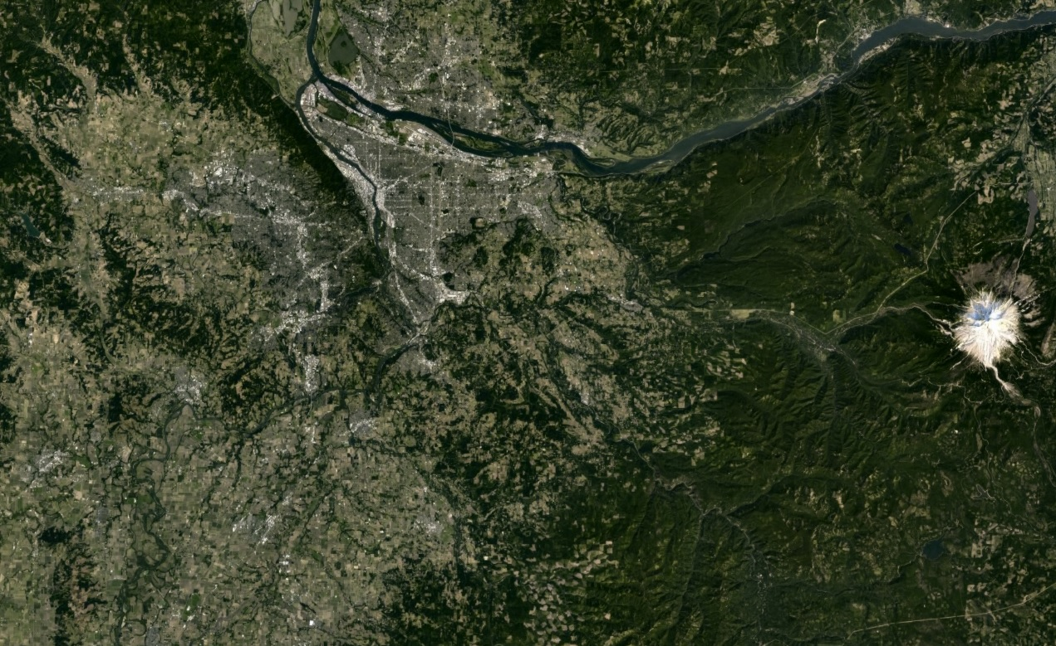

Slide 27
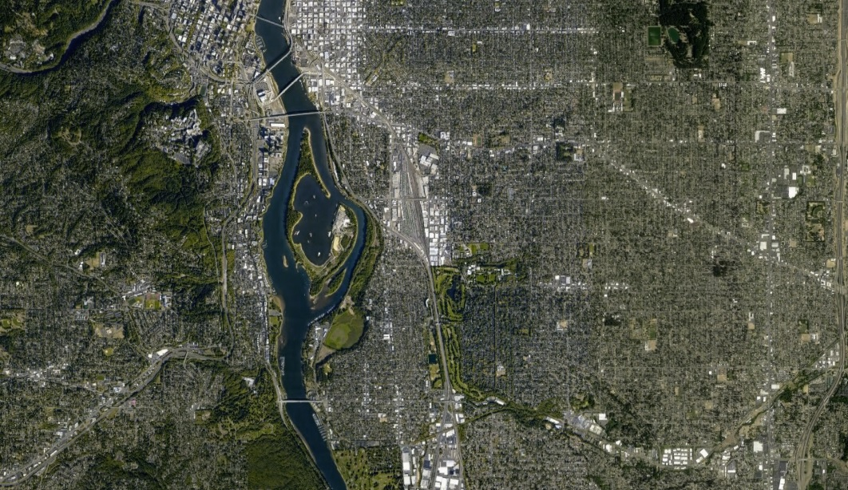

Slide 28
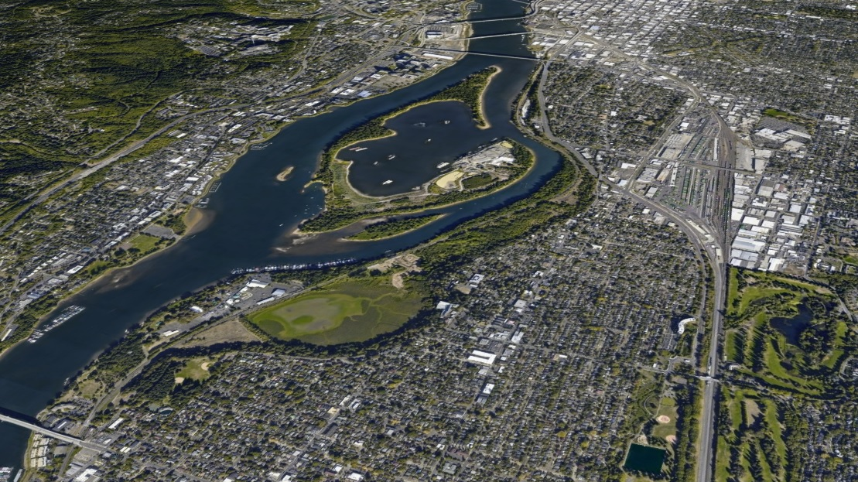

Slide 29
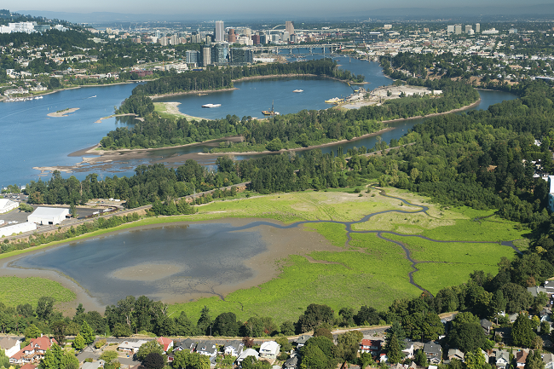

Slide 30
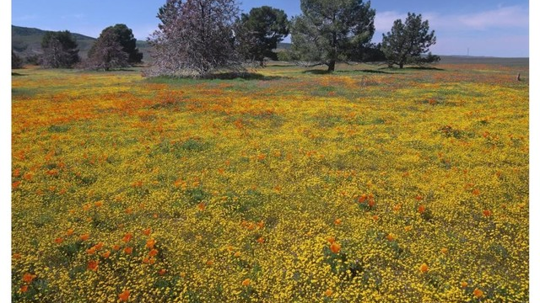

Slide 31
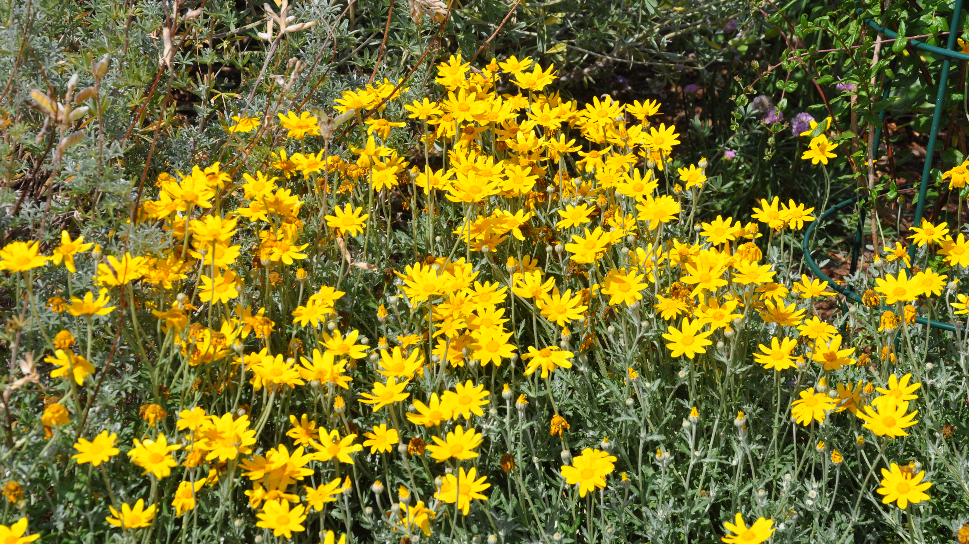

Slide 33
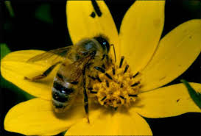
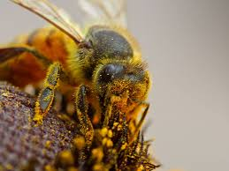

Slide 34
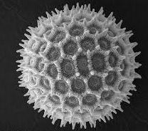

Slide 35


Slide 36


Slide 37
Express Your Questions and Opinions Critically But With Respect
The universe is vast, complex, and far beyond our current ability to fully comprehend. But it is not as much about the destination as it is about the journey. For our brief time together in this class please be mindful that there are many perspectives on what constitutes reality and contemplate perhaps no one perspective has any inherent value above any other, but rather each reflects someone’s view from their current location on one path through life.
Notes:
Sometimes our human arrogance and egos get in the way of the constructive exchange of our thoughts and ideas and thus impede our ability to understand, learn, and to grow new and better ideas. In this place where we now sit, everyone should be made to feel free to speak and to be listened to. Any responses to someone else’s comments and ideas should be given with respect and forethought.
The other reason for this other worldly lead-in is to put into perspective our place in the universe.

Slide 38
SCHEDULE
The class will consist of two 1 ½ hour lecture / workshops culminated by an optional 2 to 3-hour field trip into Oaks Bottom and surrounding landscape. Class participants will be encouraged to be actively engaged in thought provoking discussions designed to help us observe and connect with both the natural world and each other.
Thursdays 10/3, 10/10 7:00 - 8:30 pm
Saturday 10/12 9 am Sellwood Park Parking lot

Slide 39
First Class Outline
I. Introduction
II. Physical / Biological / Cultural Geography
a. Hydrogeomorphic and Ecologically Based Classifications
III. History
a. Geologic
b. Cultural

Slide 40
Second Class Outline
IV. Ecosystem Services
a. Functions and Values
Wildlife Habitat
Water Quality
Flood Retention
Scenic Beauty, Recreation, Education
b. Ecosystem Recovery
Mimic Historic Conditions
Manage for Long-term Sustainability
Evaluate Success
V. Future Forecast

Slide 41
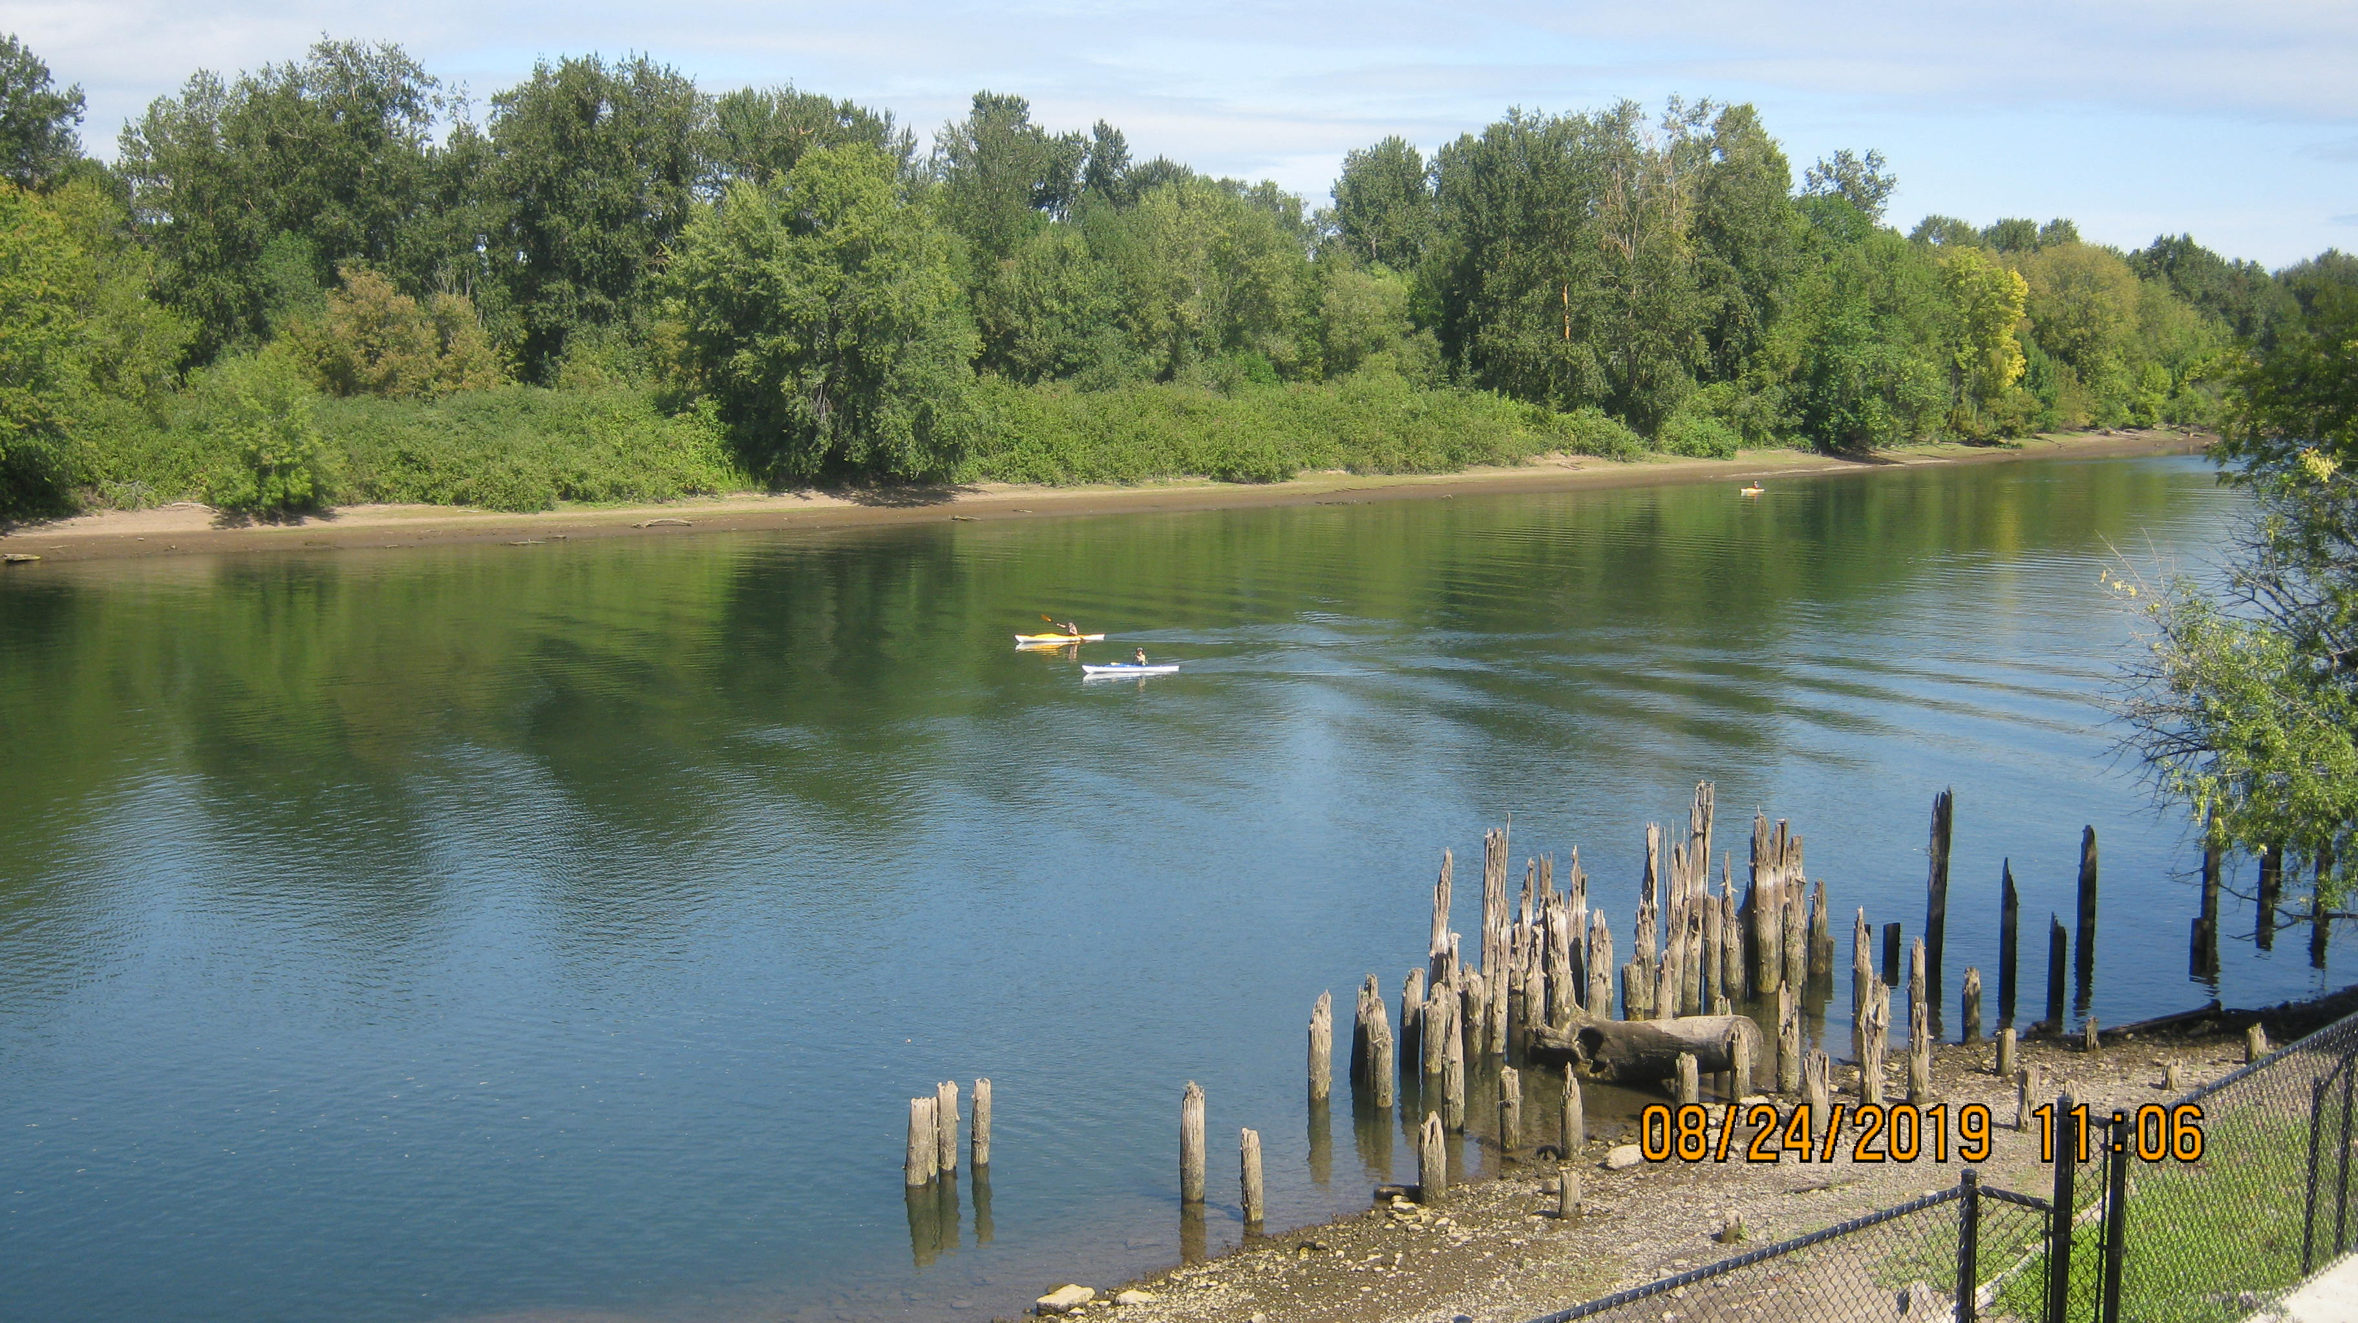
Oaks Bottom Wildlife Refuge

Slide 42
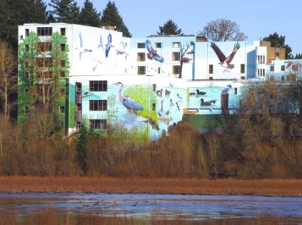
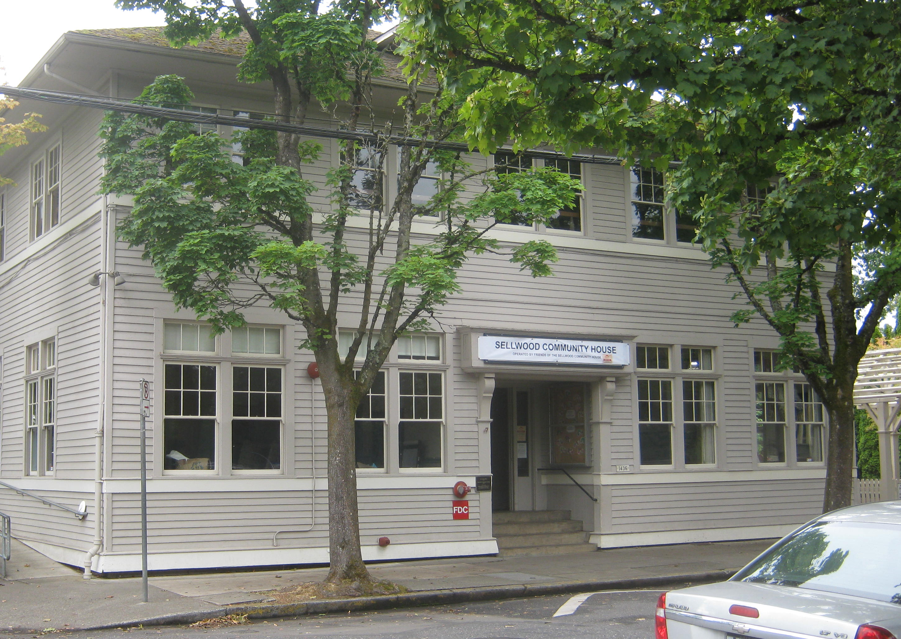
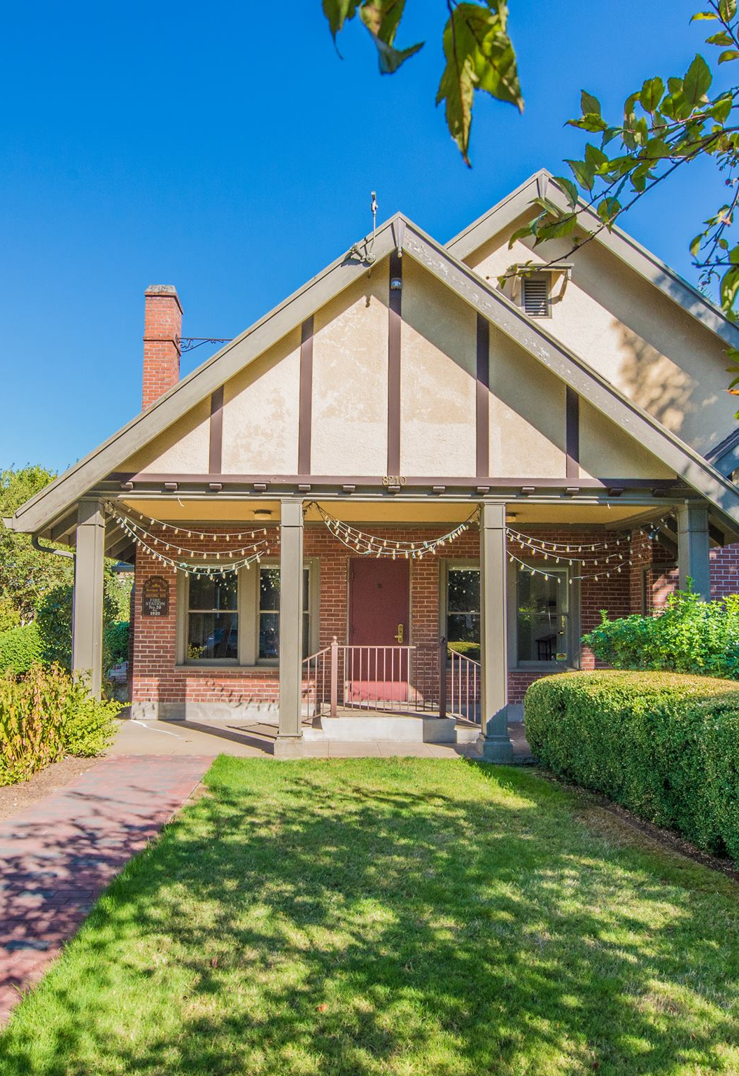
The Natural History of the Oaks Bottom Wildlife Refuge
The Oaks Bottom wetlands and associated river and upland features are arranged in a complex mosaic represented by diverse plant and animal communities revealing a story of ancient geology, fluvial geomorphology, ecology, and cultural anthropology (pre and post European settlement). It is only fitting that this unique remnant of our past, protected as an urban wildlife refuge through the joint efforts of the Sellwood Moreland Improvement League (SMILE) and the Audubon Society of Portland, be the subject of one of the first classes hosted by the SMILE initiated and reinvented Sellwood Community House.
Notes:
The establishment of the Oaks Bottom Wildlife Refuge was made possible by a combined and collaborative group effort.

Slide 43
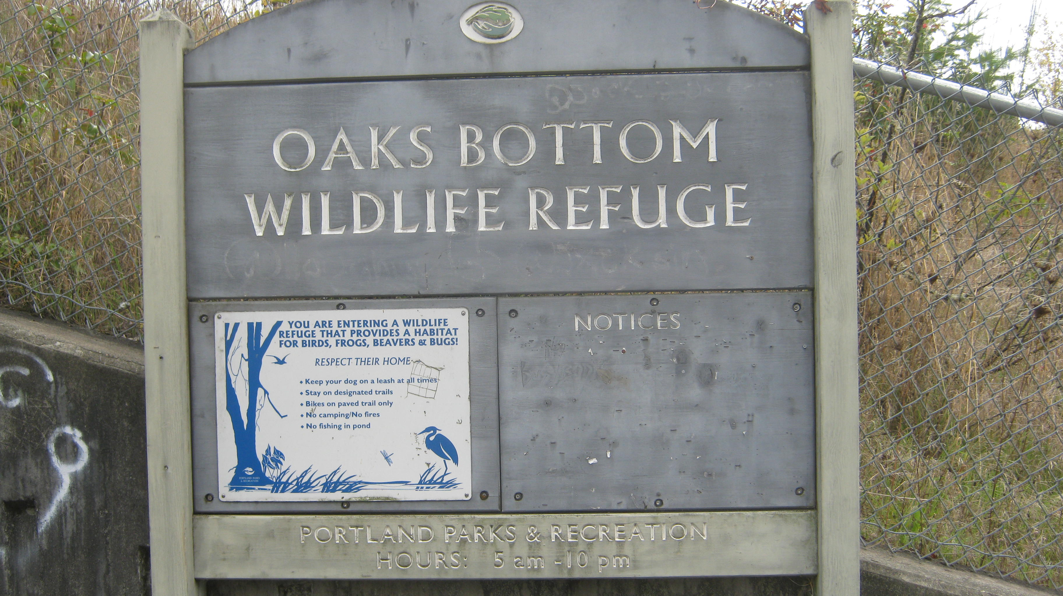
The 163-acre Oaks Bottom Wildlife Refuge north of Sellwood Park in southeast Portland is the largest remaining natural area within the lower Willamette River flood plain, with meadows, woodlands, and about 75-acres of wetlands adjacent to the Willamette River. It is home to bats, beaver, otter, mink, reptiles, amphibians, coyote, deer, and over 175 species of birds.
Oaks Bottom Wildlife Refuge
Willamette River Mile-16
45.472314, -122.663547
Notes:
This effort was in deference to the unique natural and outdoor recreational area values it offers.

Slide 44
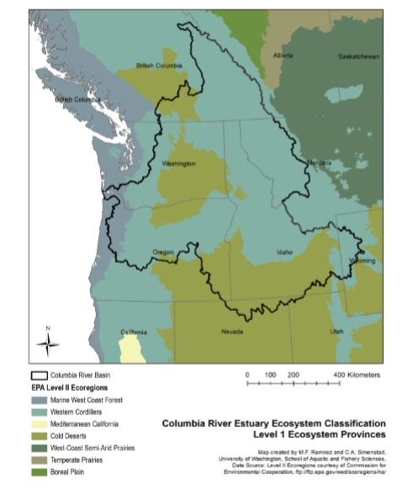
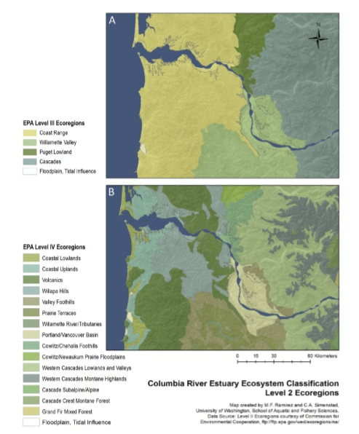
Columbia River Estuary Classification (Oaks Bottom)
Level 1 – Ecosystem Provinces
Reflect the regional variability of watersheds, which have a strong effect on the structure of estuarine systems such as the Columbia. For example, vegetation compositions differ dramatically in the different ecosystem provinces.
Level 2 – Ecoregion
Reflect ecological regions distinguished by patterns and the composition of abiotic and biotic phenomena, such as climate, geology, physiography, hydrology, vegetation, soils, land use, and wildlife. Although there may be similarities among some of these characteristics, the relative importance of each, and the interrelationship among them, varies across regions.
Notes:
Oaks Bottom Wildlife Refuge is nested within the Columbia River Basin, an area that drains nearly 250,000-square miles, including seven states and parts of British Columbia Canada. This Basin transitions between the marine environment, rain forests, deserts, and extreme alpine terrain. The refuge is further nested at the juxtaposition near the Willamette Valley Ecoregion and the Puget Trough Ecoregion, two ecoregions that many consider as counterparts of just one ecoregion.

Slide 45
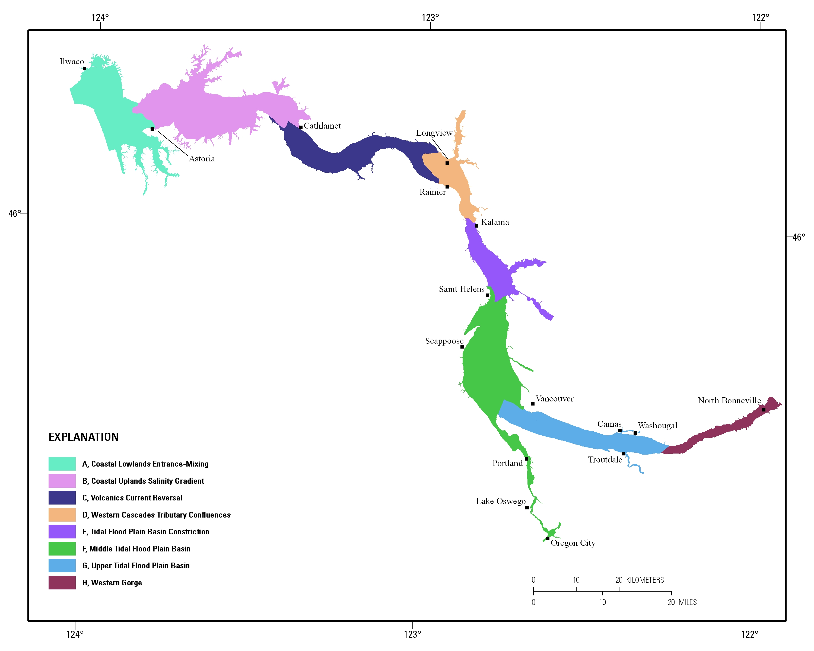
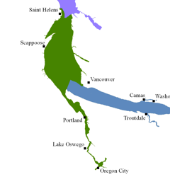
Middle Tidal Floodplain Hydro-geomorphic Reach (Oaks Bottom)
Notes:
It also sits inside a hydro (water) geomorphic (earth or landform) reach which is in the middle region of a chain of reaches comprising the Columbia River Estuary. It is probably best to think of these reaches as transitional areas from nearly a completely marine environment to one that is mostly dominated by freshwater riverine conditions and only vestigial influences by the Pacific Ocean.

Slide 46
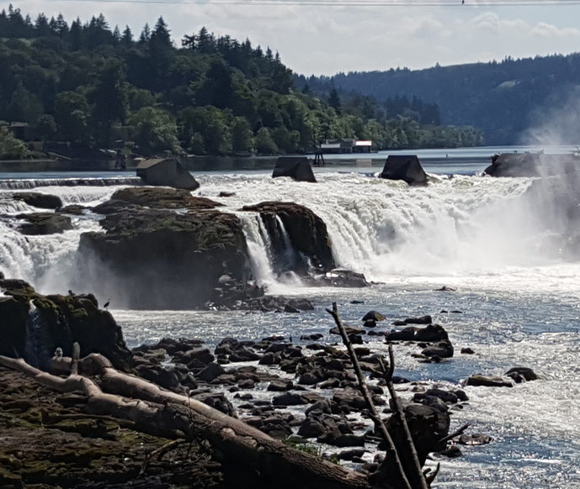
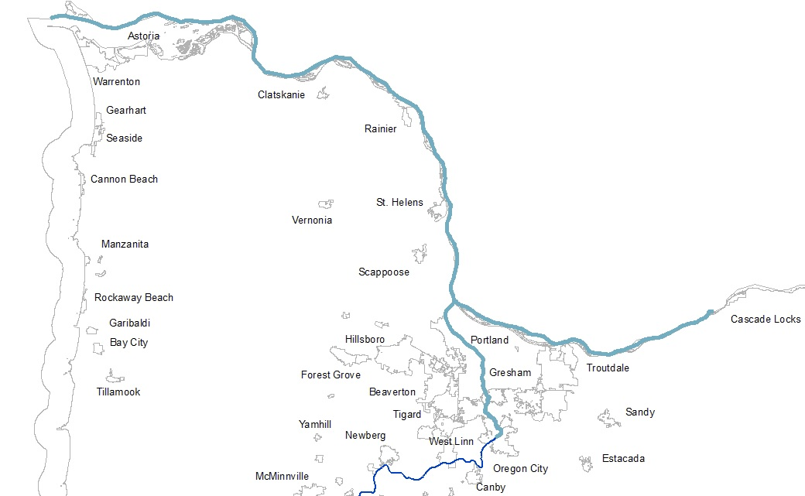
Columbia River Estuary Upstream Limits (Willamette River Falls)
Columbia River
Willamette River
Notes:
The upper limits of the Columbia River Estuary are at the heads-of-tide or those places longitudinally along the river where tidal influence stops. There are two major heads-of-tide on the main stems of the Columbia and Willamette Rivers, but there are also a significant number of smaller ones on the many tributaries that flow into these rivers before they collectively flow into the Pacific Ocean.

Slide 47
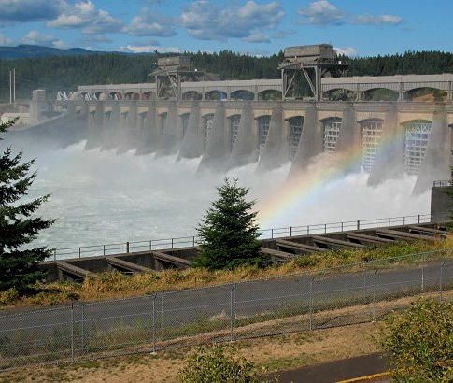
Columbia River Estuary Upstream Limits (Bonneville Dam)
Columbia River
Willamette River

Slide 48
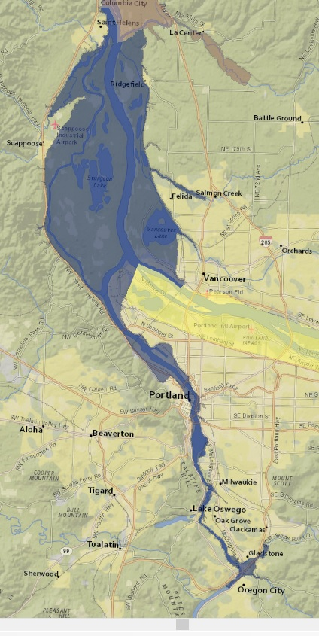
Oaks Bottom is Nested Within the Middle Tidal Flood Plain Basin (Level 3-Hydrogeomorphic Reach)
This is the widest hydrogeomorphic reach of the upper estuary where the flood plain is composed of wetlands and many seasonal ponds within bar-and-swale deposits and scoured bedrock areas, as well as terraces and rocky outcroppings. Many of the associated wetland complexes are separated from the mainstem river channels by slightly higher flood plain bar-and-swale deposits generated by lateral channel migration. It is circumscribed by many circuitous sloughs and tidal channels connecting swale wetlands embedded in the bar-and-swale topography. Dikes, levees, road and railroad grades and drainage ditches have locally altered the hydrology along this reach. It is influenced by flooding from the “pineapple express” coastal storms, including five floods at least 3-m above Willamette River flood stage since 1876. This hydrogeomorphic reach has relatively little tidal influence, particularly during high river discharge.
Notes:
One of the primary reasons for breaking up the Columbia River Estuary into a series of hydro-geomorphic classes is that each class is considered to represent a unique set of conditions that set the stage a bit differently for how the abiotic environment intersects with the life-cycle needs of the living or biotic environment. This is especially important for ecological monitoring and restoration planning considerations. The Oaks Bottom Wildlife Refuge comprises an example of the expression of off-channel habitat typical of the ‘Middle Tidal Floodplain reach.’ For nearly a century it was cut-off from the main channel be a railroad grade that essentially acted as a dike. While there was one culvert connecting the area to the river, it was primarily to facilitate wetland drainage and any juvenile anadromous fish that did manage to make it through were likely at high risk of stranding and / or predation and the subsequent premature truncation of their downstream migration.

Slide 49
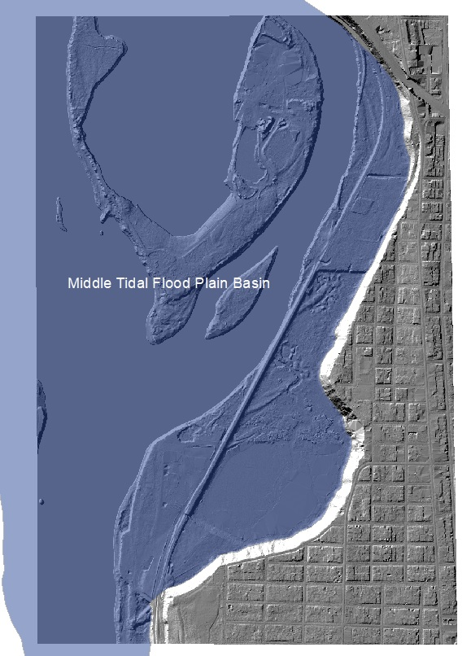
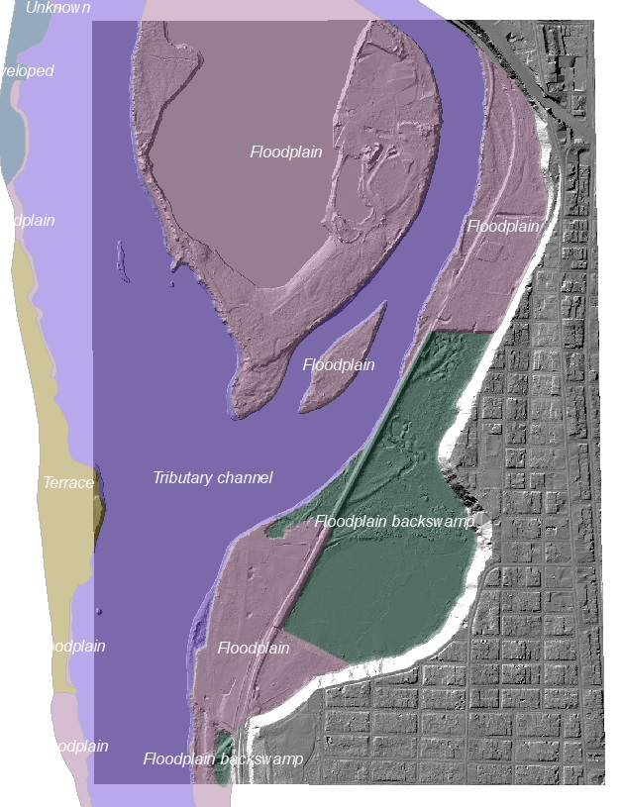
Columbia River Estuary Classification (Oaks Bottom)
Level 3 – Hydrogeomorphic Reaches
Incorporate indicators of ecosystem structure and process that encompass and assimilate tidal freshwater contributions to flood-plain processes and tidal-fluvial interactions along the estuarine gradient.
Level 4 – Ecosystem Complexes
Biophysical patches formed by long-standing geologic and hydrologic processes that establish long-term geomorphic features in the estuary as well as more recent hydrologic and geomorphic processes, including those established by anthropogenic activities and structures.
Notes:
The hydrogeomorphic reach is further broken down into nested classes such as floodplains. Floodplains are essentially areas of relatively low relief and gradient where river waters overflow upon reaching specific gauge heights relative to their confining banks. Biologically during flood stage they can become important feeding and refuge areas for juvenile salmonids as well as hunting and feeding opportunities for waterfowl, shorebirds, and other wildlife.

Slide 50
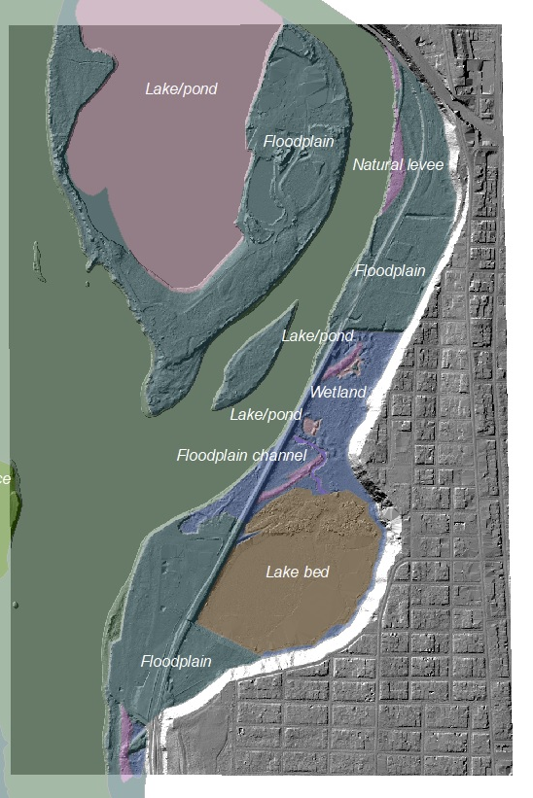
Columbia River Estuary Classification (Oaks Bottom)
Level 5 – Geomorphic Catenae
Are classified and delineated within ecosystem complexes. Multiple mapping criteria and sources are used to distinguish water body and flood-plain features occurring within each complex; and primary cover class data are applied in conjunction with other geospatial data (for example, LiDAR) to delineate discrete biological communities associated with geologic/geomorphic units.
Notes:
Floodplains are further distinguished by specific aquatic features that they contain such as wetlands, lakes, ponds, etc. In this tier of classification. Variations in vegetation and use by fish and wildlife are also highly correlated with these features identified at this level of classification.

Slide 51
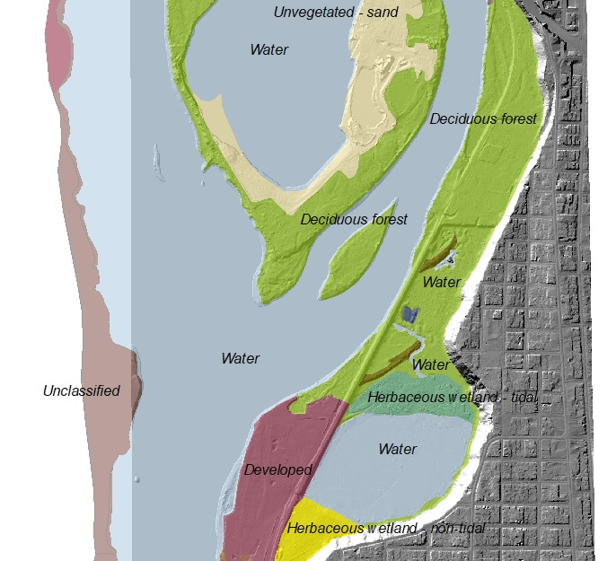
Columbia River Estuary Classification (Oaks Bottom)
Level 6 – Primary Cover Class
Nested in the Level 5 geomorphic Catenae are Sub-catenae or cover classes that for example further subdivide vegetation categories based on structural, and hydrologic criteria and differentiate substrate types by particle size.
Notes:
In this level of the classification wetlands and non-wetlands are even further distinguished by their specific cover types (e.g., developed), vegetation structure and leaf character, tidal regimes, substrate particle size, etc.

Slide 52
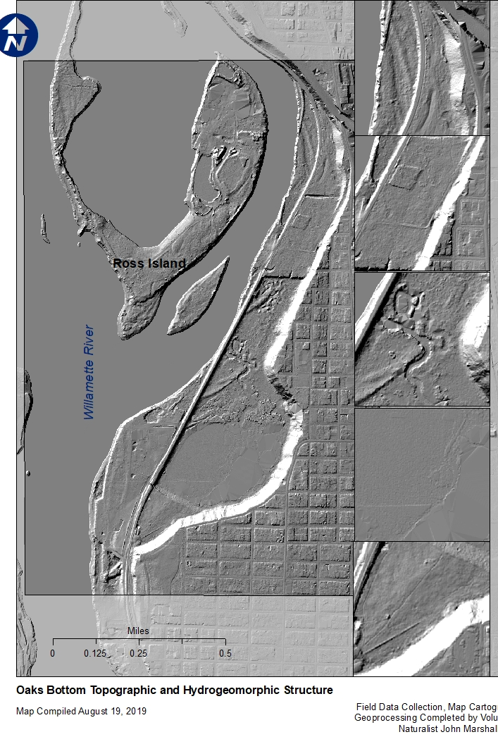
Hydrogeomorphic Classification
Tidally Influenced – Yes = Estuarine
                No (While there is a tidal influence it is not considered the primary hydrologic driver for this wetland)
                Closely Associated with a channel or a floodplain -
                Yes = Riverine
                Scoured Floodplain No Seasonal Ponding = Riverine Flow-through (RFT)
                Not Scoured Permanent or Seasonal Ponds =
                Riverine Impounding (RI)
RI
Bare Earth LiDAR Hillshade Image of the Oaks Bottom in 2014
Notes:
There is another hydrogeomorphic wetland classification (HGM) used in Oregon that is embraced and codified by the Oregon Department of State Lands and authored by Paul Adamus in a number of documents, including several ‘guidebooks’ that stems from early 1990s work by the US Army Corps of Engineers (Brinson et al). The hillshade view of the LiDAR (Light Detection and Ranging) imagery illustrates the Riverine Impounding classification designation at the Oaks Bottom Wildlife Refuge.

Slide 53
USFWS Cowardin Systems and Subsystems
Marine and Estuarine – Subtidal or Intertidal
Riverine – Tidal
Lower Perennial (low gradient) Upper Perennial (high gradient) Intermittent
Lacustrine – Limnetic or Littoral
Palustrine – No Subsystems
Notes:
Another wetland classification commonly known as the Cowardin or USFWS Classification is applied to Oaks Bottom Refuge. Under this classification the Refuge occupies an area that is both riverine tidal and lower perennial and has both elements of Lacustrine (Littoral – shallow water) and Palustrine persistent emergent and woody vegetation.

Slide 54
Cowardin Classes
Rock Bottom
Unconsolidated Bottom
Aquatic Bed
Rocky Shore
Unconsolidated Shore
Emergent Wetland
Scrub-Shrub Wetland *
Forested Wetland *
*These classes if present automatically fall into the Palustrine System
Notes:
The Oaks Bottom Refuge contains most of the classes in the Cowardin classification.

Slide 55
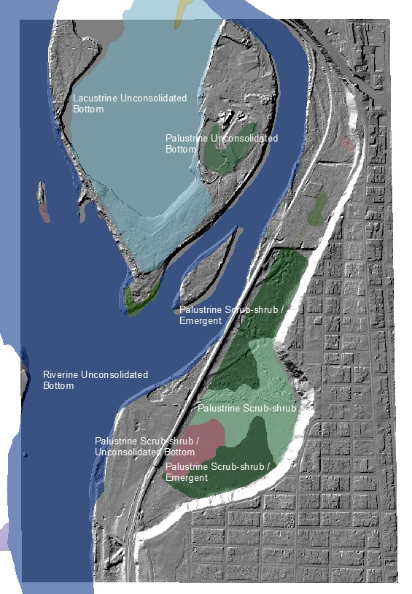
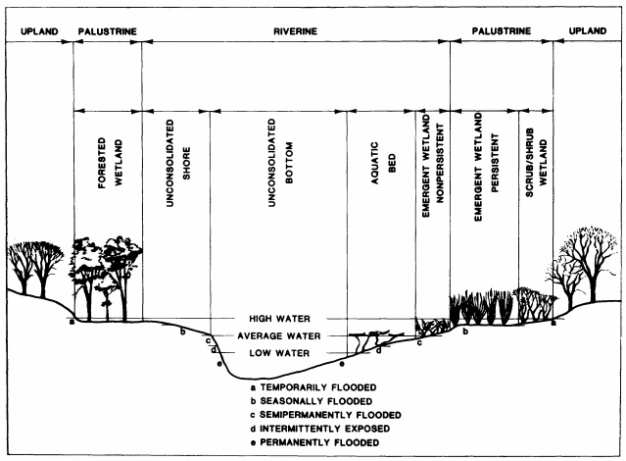
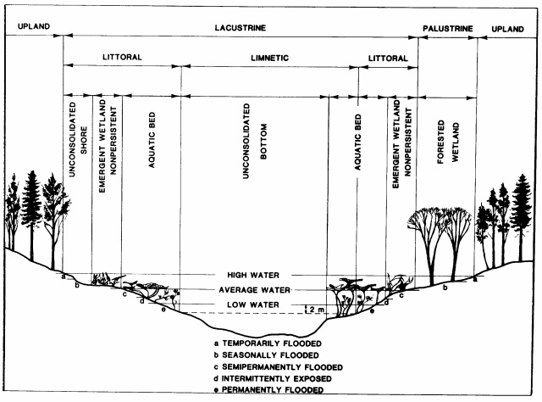
National Wetland Inventory(NWI) Classification based on USFWS Cowardin (Oaks Bottom)
Notes:
This slide displays the National Wetland (based on the Cowardin classification) Inventory applied to the Oaks Bottom Wildlife Refuge. It should be noted that this inventory is applied using small scale aerial imagery over the entire United States and has limited ground truthing to validate the mapping.

Slide 56
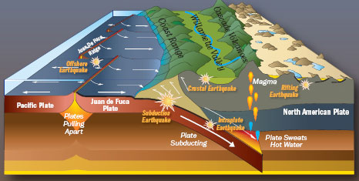
Willamette Valley Origin
The Willamette Valley is a fore-arc basin that formed in response to subduction of the Pacific Plate beneath the North American Plate. Tertiary marine sandstones form the basement of the Willamette Valley, which was separated from the Pacific Ocean approximately 20–16 Ma when submarine volcanic rocks were uplifted, forming the Coast Range. About 15 Ma, subareal flood basalts of the Columbia River Basalt Group (CRBG) flowed westward from eastern Oregon, covering large portions of the northern Willamette Valley.
Notes:
In the mid 1980s , while working for the Oregon Department of State Lands, I found myself one day standing out on a wetland fill violation site in Warrenton Oregon near a place on the Columbia River called Alder Cove. I glanced out at a maze of open ditches that had been dug to install water and sewer lines and asked to my Corps of Engineers counterpart, Jerry Black, if he knew why for as far as the eye could see there was a black stripe several inches thick and several feet below the ground surface. He said that he didn’t know but that he had grown up in that area (he was then in his 60s) and that these stripes had been around as long as he could remember. I asked my major professor at Oregon State University about it and he also did not have an explanation. Now days we know the black lines are buried saltmarshes left as records of Cascadia subduction events occurring at 9.0 Richter scale levels on a repetitive 350+/- year recurrence interval.

Slide 57
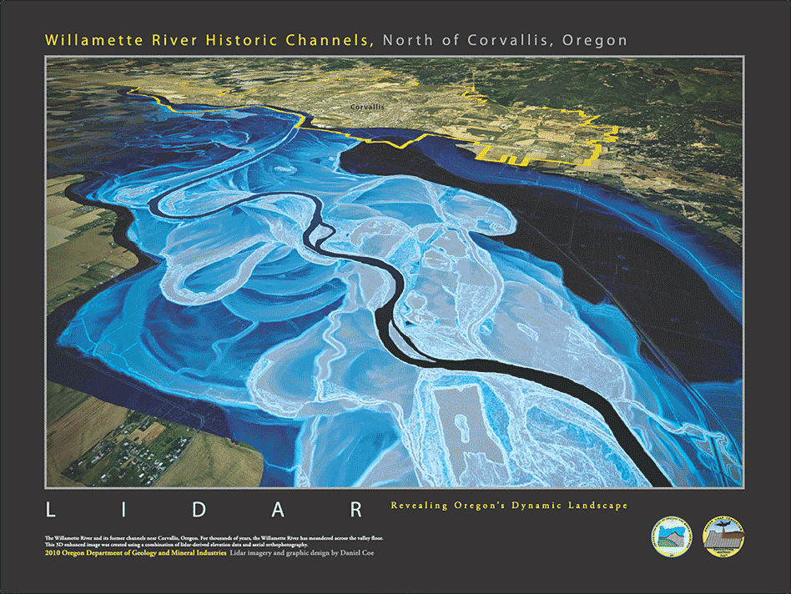
The Geologic History of the Willamette Valley
About 20 mya: A shallow inland sea existed where the valley is today. About 15 mya: Valley floor uplifted and Cascade Mountains formed creating the Willamette Valley roughly as we see it today. During the last great ice age (40 to 13 thousand years ago) the ice sheets did not reach as far south as Oregon. BUT 15-13 thousand years ago several dozen great floods - known as the Bretz Floods or Missoula Floods - occurred across the entire Columbia Basin and flooded the Willamette Valley to a depth as high as 400-feet. Much of the topsoil in the Willamette Valley was left behind by these great floods.
Notes:
So the Willamette Valley is essentially a plate tectonic related feature that as early as 2-mya likely looked much as the Puget Sound does today. More recently a combination of uplifting, drainage, and periodic catastrophic flooding contributed to many of the observable landforms found in the Valley today.

Slide 58
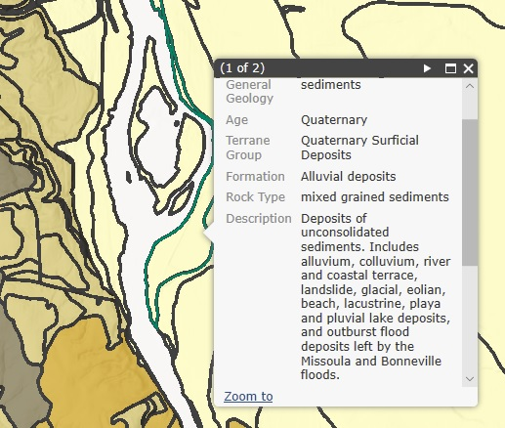
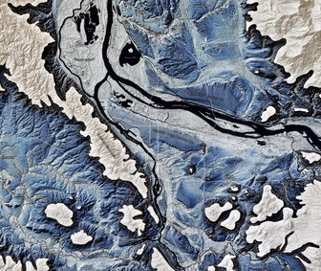
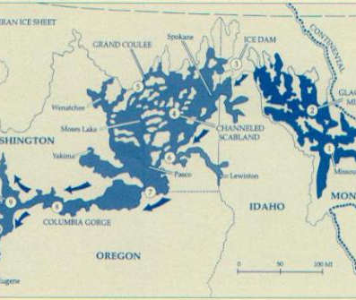
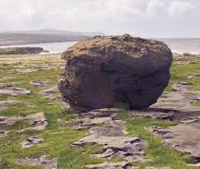
Catastrophic Pleistocene Floods
These catastrophic floods originated from a reoccurring glacially dammed Lake Missoula. When the dam periodically broke, the lake drained across south-eastern Washington and flowed down the ancestral Columbia River Gorge. It back-filled into the Willamette River Valley when it reached its confluence with the Columbia River and finally deposited fine-grained silts and clay sediments on the valley’s floor. While these ice age floods left significant sediment deposits (ranging in thickness from 35-m in the northern valley to less than 5-m in the southern end), they also resulted in significant scour features that are presently acting as groundwater discharge sources that help support the hydrology of the wetland features now established around many of them.
Notes:
A ‘biscuit-swale’ landscape persists today in much of eastern Oregon and Washington and the Willamette Valley as a record of these periodic Bretz flood events. Bretz origin scour features are often sources of groundwater discharges that support hydrologic inputs of numerous contemporary wetland features.

Slide 59
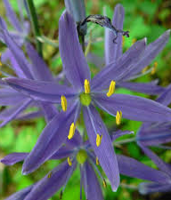
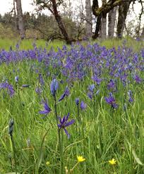

Native Americans of the Willamette Valley, Oregon
When early European settlers arrived in the area that we now call Western Oregon, they encountered a landscape quite different from what we see today. Much of the Willamette Valley was an open oak savannah, interdigitated with curvilinear swales of wet-grass prairie and convex ridges of upland prairie, reflecting centuries of intermittent aboriginal and natural lightning set prairie fires.
Notes:
The Willamette Valley looked much differently before Europeans arrived than it does today.

Slide 60


Native Americans of the Willamette Valley, Oregon
A branch of the Chinooks called the Clackamas lived along the Willamette River near the Oaks Bottom area and traded with the Kalapuyan to the south near the Willamette Falls, where they also fished for salmon. They were peaceful people whose lively-hood revolved around fishing, hunting, gathering, and trading. During the winter, the Clackamas lived in cedar plank lodges that provided shelter for three or four families.
With low immunity to smallpox, measles, malaria, and venereal diseases introduced by European fur traders in the late 1700s, most of the Chinooks and other Willamette Valley Native peoples were dead before the mid 1800s, Their totems, built to help record their tribal histories and cultural ways, were burned by European missionaries while the U.S. Calvary forced the remaining living native Americans to stay on reservations so the European settlers could steal their traditional hunting and fishing territories.
Notes:
The native inhabitants of the Willamette Valley were nearly completely wiped out within a relatively few years of exposure to European born diseases.

Slide 61



General Land Office Survey
The General Land Office (GLO) oversaw the surveying, platting, and sale of public lands in the Western United States and administration of the Homestead Act. Under the Donation Land Claim Act, for a small filing fee, single white citizens who had arrived prior to December 1, 1850 were allowed to claim 320 acres, married couples 640 acres.
Government surveyors, who recorded the terrain and soil types, water bodies, types of trees, and undergrowth in field notebooks and on sketch maps as they traveled along every section line in 1851 and 1852, presented a more precise description of the Sellwood-Moreland landscape.
John Sellwood, the namesake of the Sellwood-Westmoreland neighborhood, acquired the 32I-acre parcel in the original Henderson Luelling and William Meek donation land claims from Henry Miller and Joseph Lambert in 1866.
Notes:
Ironically, the same survey efforts that allowed the Federal government it mete out homesteads to early pioneers, today serves as an important information record from which to plan restoration of historically diminished natural resources.

Slide 62

Oaks Bottom Wildlife Refuge Surrounding Area Recent History
By the early 1900s, two interurban rail lines linked the Cities of Gresham and Portland. One line ran down East Burnside (paralleling the current Max Blue Line) through the northern portion of Centennial and the other ran along Johnson Creek and the Willamette River (along what is now the Springwater Corridor). Residential development naturally occurred along these lines.
In the 1930s, the Work Projects Association (WPA) attempted to control flooding by widening, deepening, and rock-lining Johnson Creek, creating a dredged channel in 15 of the 25-stream miles. Dirt was used to fill in much of the historic wetland and floodplain. In later decades, towns and neighborhoods were built up to the creek banks.
These kinds of actions became commonly applied long into the future over entire watersheds and cumulatively resulted in the disconnection of rivers and creeks from their floodplains, degrading channels, displacing bank stabilizing and water shading vegetation, removing large wood (and large wood recruitment) critical to fish and wildlife, removing riparian habitat, and substantially altering overall stream and river configuration.

Slide 63



Work Projects Association Dam Construction
Built to create a renewable energy resource, navigation, irrigation, and flood control but have proven to be a major impediment to the survival and sustainability of native wild salmonid populations in the region.

Slide 64


South Oaks Bottom Wildlife Refuge Prior to Landfill
Two oblique aerial images show the southern end of Oaks Bottom Wildlife Refuge prior to the landfill and prior to the weir installation (top photo is looking from northwest to southeast early 1960s and bottom photo is looking from southeast to northwest early 1930s).

Slide 65

Channel Simplification Over Time
Over the past 150-years the complex braided channel system of the Willamette River has been modified into mostly a single channel through activities such as diking and riverbank stabilization to promote agriculture, a stable land-based transportation system (e.g., roads and railways), and urban development.
Notes:
The bad news is since the European settlements began, over the past 150-years the overarching condition of the Willamette River’s had shifted over to one that is primarily human influenced motivated by goals to stabilize riverbanks (riprap), enhance land and water navigation (dredging and filling), and to control flooding (dredging, dikes, dams). The overarching result was a gradual transition from a multiple channel complex to what is today essentially a single channel system. Of course, this has also contributed to a significant reduction to fish and wildlife habitat in the Valley.

Slide 66
Pivotal Environmental and Cultural Resource Laws
The Migratory Bird Treaty Act (MBTA) of 1918
Fish and Wildlife Coordination Act of 1934 (FWCA)
National Historic Preservation Act of 1966 (NHPA)
The National Environmental Policy Act of 1969 (NEPA)
Coastal Zone Management Act of (CZMA) 1972
The Clean Water Act of 1972 (CWA)
Endangered Species Act of 1973 (ESA)
Senate Bill 100 of 1973 – Statewide Land Use Planning (Goals 5, 15, 16, and 17)
State Removal-Fill Law of 1967 with 1981 and 1984 amendments (RFL)
Notes:
A number of regulations and policies must be understood and adhered to when considering and implementing actions that may have an adverse effect on these ecosystem services. This is a list of some of the more common Laws, but it is far from exhaustive. Even actions that are considered beneficial to ecosystem services must go through regulatory review, albeit expedited, just to ensure trust agency confidence the beneficial actions really will be beneficial.

Slide 67













Scientific / Cultural Revolution
Northwest Power Act (1980)
Between the 1970’s and 2019, there has been a scientific and cultural revolution progressing on many fronts.
Federally Listed
Salmonids in the Late
1990’s
Columbia River Estuary Data Development Program
Federal Judge George Boldt issues
historic ruling affirming Native American
treaty fishing rights on February 12, 1974
Notes:
The good news is that probably starting in the late 1960s but well under way by the 1980s, has been a scientific and cultural revolution that is contributing to major changes in how we view and manage our aquatic and upland natural resources. Our technical tools for managing data and information, including spatial data are several orders of magnitude more advanced than what was available even less than 20-years ago. We have managed to take a more wholistic approach to a watershed level management strategy vs a single site / single study approach and have begun to embrace the conventional wisdom of regional mapping and trends analyses to inform future planning and regulatory decisions, as well as overall recovery efforts for their own sake outside of the regulatory process. Also, tribes have become increasingly important allies in the protection and the recovery of our natural resources. In addition conservation and mitigation banking are now important tools in our toolbox for natural resource conservation and restoration, as well as increased funding from multiple programs to bring recovery up and over the brink of ‘no-net-loss.’

Slide 68


Significant Management Problems and Solutions Identified at Oaks Bottom in 1988
Time series aerial photos indicating succession from open water to willow swamp was occurring gave rise to a management objective for establishing weirs for water control in order to set-back the successional advances of the woody species and at the same time to reduce the extent of a large area then dominated by nonnative invasive reed canarygrass. Purple loosestrife was just barely on the radar as a potential noxious weed in 1988.
Note: Two ‘specialists’ species of Galerucella (beetles) have been introduced onto the Oaks Bottom Wildlife Refuge Purple loosestrife pop-ulations as a biological control.
Notes:
Two ‘specialists’ species of Galerucella (beetles) have been introduced onto the Oaks Bottom Wildlife Refuge Purple loosestrife populations as a biological control.

Slide 69






A Shifting Strategy: Infrastructure to Greenfrastructure
AKA
From ‘Design Against Nature’ to ‘Design with Nature’
  Legacy Strategy Progressive Strategy
  (Engineered) (Bio-remedial)
  Flood Control
  Dams, Dikes, Construct to Plan Plan to Construct, Infiltration, Protect Floodplains / Wetlands,
  Detention
  Water Quality
  Engineered Treatment Protect Floodplains / Wetlands, Constructed Wetlands
  Fish and Wildlife Habitat
  Single Species as a Crop Focus Ecoregion Plant and Animal Community Sustainable Recovery
Notes:
Design with Nature vs Design over Nature . . . Evidence of this revolution can be found throughout the Pacific Northwest, including the Oaks Bottom Wildlife Refuge. We will have quite a bit more discussion about this project before we are done.

Slide 70



Maritime and Mediterranean Climate
Precipitation is generally driven by moist Pacific storms forced into orographic cooling, first by the Coast Range and second by the Cascade Mountains. The Willamette Valley typically has wet cool winters and springs followed by warm dry summers and early falls. This pattern’s similarity to the Mediterranean region led to it’s labeling as a ‘Mediterranean Climate.’
Notes:
As tropical storms pour into the Pacific Northwest the warm moist air is forced up and over two successive mountain ranges before moving over the mountain peaks and then down into a great basin desert region on the east side of the Cascades. As the air rises it both expands and cools causing the water vapor to condense to a liquid and accumulate on dust particles until the weight gives way to gravity and falls as precipitation. As the now drier air moves over the mountain crests it sinks and warms as its density increases and its dew point rises proportionally. It should be noted that condensation releases significant amounts of latent heat which acts to help moderate (reduce the variation) temperatures in these leeward coastal areas (AKA a maritime influence). The overall temperature / rainfall pattern in this region is moist cool winters and springs and warm / dry summers and early falls. The similarity this pattern shares with the lands near the Mediterranean Sea have caused climate aficionados to tend toward referring to it as a ‘Mediterranean Climate.’ It is this weather pattern that largely influences having conifers dominate western United States forests ad deciduous trees dominating forests in the eastern United States. Conifers have a waxy needle or scale-like leaf (sclerophyll) that has superior water retention capacity as compared with broadleaf trees leaves.

Slide 71
Oaks Bottom Wildlife Refuge Hydrology
Input Output
Precipitation Evaporation and Evapotranspiration
River (High flow) River (Low flow)
Groundwater Springs
Notes:
The Oaks Bottom Wildlife Refuge in Portland, Oregon has a water budget that persists under this climate pattern.

Slide 72
Rain
Rain
Rain
Rain
River Exchange
Evapotranspiration
Evaporation
Springs
Evaporation
Evapotranspiration
Springs
Evapotranspiration
Springs
Notes:
The surface water at the refuge waxes and wanes seasonally but has groundwater sources even in the late summer draught that prevents a complete drawdown.

Slide 73

Hydrology
Willamette River Morrison Bridge River Gauge 2017 Seasonal Hydrograph
Measured in Feet at MLLW Datum:
Which is the average height of the lowest tide recorded at a tide station each day during a 19-year recording period, known as the National Tidal Datum Epoch. MLLW is only a mean, so some tidal levels may be negative relative to MLLW.
Notes:
Water flows highest in the Willamette River during the spring freshets and will flow into the Oaks Bottom Wildlife Refuge when the river levels exceed the elevation at the bottom of the adjoining culvert and will then flow back out during the mid to late summer when the river levels are lower than the elevation at the bottom of the culvert.

Slide 74

Hydrology – Willamette River Morrison Street Bridge Tide Gauge
Elevation of River in Feet at MLLW Datum
Notes:
The Willamette River experiences two high-tides and two low-tides every 24-hours and these tides can effect water levels in the Oaks Bottom Refuge during periods when the river’s overall level is at or above the elevation of the bottom of the adjoining culvert. These tides are driven by the ocean tides that ebb and flow with the earth’s rotation and the lunar cycles. It can be thought of as an ‘Archimedes’ effect.

Slide 75


A Potential River Water Exchange Period at Oaks Bottom Based on Data
15-Feet NAVD 1988 ~ 8.42-Feet MLLW
Willamette River Mile-16
Note: 2014 LiDAR does not Reflect elevations after 2018 culvert replacement and channel dredging project.
Notes:
Using bare earth (last return) LiDAR (Light Direction and Ranging) at NAVD 1988 a datum conversion to MLLW allows a visualization of one potential inundation period at the Oaks Bottom Wildlife Refuge.

Slide 76
Land Elevations – Oaks Bottom at Culvert Connection to Willamette River
15-Feet NAVD 1988 ~ 8.42-Feet MLLW
Elevation of Contours in International Feet at NAVD Datum 1988
Notes:
The LiDAR sources provide metadata to help users understand the data attributes.

Slide 77

Oaks Bottom Wildlife Refuge Artesian Springs
Myth or Reality?
Notes:
The aquifer that feeds Crystal Springs is likely the same aquifer contributing to the groundwater discharges int the Oaks bottom Wildlife Refuge. It is possible that at least one of those springs flows under an impervious restrictive layer, contributing to an artesian well effect near the eastern edge of the wetland.

Slide 78
20th-Century Oaks Bottom Anthropogenic Influences
Oaks Amusement Park in 1905
Railroad Line to Bring Visitors to the Park
Two Oaks Bottom Landfills in the 1960s
Protection as City Wildlife Refuge 1980s
Oaks Park Weir Installation 1990s
Notes:
So, in summary the primary human related activities affecting the Oaks Bottom Wildlife Refuge are: 1) the adjacent development of an amusement park, 2) a railroad initially built to bring visitors the Park and later used primarily to run freight trains, 3) municipal waste landfill on the south end and freeway waste landfill on the north side, 4) protection of natural resources in the 1980s, and 5) an experimental weir installation in the early 1990’s primarily aimed at controlling reed canarygrass, which it did at the expense of many trees and shrubs and the subsequent population explosions of purple loosestrife!

Slide 79
21st-Century Oaks Bottom Anthropogenic Influences
Migratory Bird Park 2004
Oaks Park Weir Removal / Culvert Replacement 2018
Planning and Restoration Efforts
Vegetation Management
Notes:
Oaks Bottom became Portland's first wildlife refuge in 1988, and in 2004 it was designated the Portland's first migratory bird park. The migratory bird park designation is thanks in part to a $50,000 grant from the U.S. Fish and Wildlife Service to maintain a refuge for thousands of migratory birds that make annual flights north and south. The “Oaks Bottom Tidal Restoration Project” was carried out by the City of Portland Bureau of Environmental Service and the United States Army Corp of Engineers, in partnership with the Lower Columbia Estuary Partnership, and the United States Fish and Wildlife Service. The largest part of the project is the replacement of an outdated culvert that is an impediment to the fish and the stream feeding the wetlands inside the natural area. A new larger box culvert will allow them to pass easily in and out from the Willamette River to the marshland. Likewise, the water channels of the slough will be improved with appropriate habitats to help young salmon from their spawning grounds to the ocean. It will make it usable for all the wildlife travel under the railroad and the trail at all times of the year. It is part of the city's salmon recovery program to help restore the natural ebb and flow of water in and out of Oaks Bottom Wildlife Refuge.

Slide 80
Flood Storage / Stormwater
As watersheds become more covered with impervious surfaces such as highways, roads, and parking lots, the rainfall during storm events runs into the nearby streams and rivers at faster rates and the flood crests proportionally arrive sooner during the storms and rise to higher elevations and greater velocities in the floodways. Channel degradations leading to streams being disassociated with their floodplains are typical consequences of the runoff increases. Natural wetlands in conjunction with Low Impact Development and Green Infrastructure can serve to help offset or mitigate these impacts.
Notes:
As watersheds become more covered with impervious surfaces such as highways, roads, and parking lots, the rainfall during storm events runs into the nearby streams and rivers at faster rates and the flood crests proportionally arrive sooner during the storms and rise to higher elevations and greater velocities in the floodways. Channel degradations leading to streams being disassociated with their floodplains are typical consequences of the runoff increases. Natural wetlands in conjunction with Low Impact Development and Green Infrastructure can serve to help offset or mitigate these impacts.

Slide 81




100-year Floods
1996
1894
1948
1964
Notes:
Clearly, the ‘100-year flood’ occurs more than once every 100-years, so why do we call it the 100-year flood? Discuss the 0.01 probability definition of a100-year flood.

Slide 82

Oaks Bottom Wildlife Refuge in 1948 Flood
Notes:
So, it appears Oaks Bottom Wildlife Refuge fills to its full flood retention capacity during the 100-year floods. Keep this in mind when we start talking about the flood retention functional capability of this particular wetland.

Slide 83


When Oaks Bottom Wildlife Refuge Floods Structures and Lives are Not in Danger . . .
When Oaks Amusement Park Floods Structures and Lives Are in Danger . . .
Notes:
…also note that when Oaks Bottom Wildlife Refuge floods there are no ‘in-situ risks’ to property and life but next-door at the Oaks Park there are such risks. Again, keep this in mind when we talk about the flood desynchronization and mitigation functions of this wetland site.

Slide 84


Wetland Ecosystem Services (Oaks Bottom)
SERVICE Wt. RANK
Flood Retention and ML Desynchronization
Position in the Watershed H L
Percent of Watershed Area H L
Position Relative to Urban M M Development
Roughness Coefficient M M
* Flood Protection by Displacement
Notes:
Primarily because of its place in the contributing watershed (nearly the entire Willamette Valley), Oaks Bottom Wildlife Refuge has a moderate to low ability to keep floodwaters away from downstream structures. It’s greatest contribution to flood protection is probably that since it is a mostly natural undeveloped floodplain, there are no structures at risk to flooding on the refuge. Another way to say it is, one of the best ways to avoid flood damage is to build outside of the floodplain! Who generally pays for the property damages from flooding? Can we say that the Oaks Bottom Refuge is saving people money? Finally, having said all that who can say whether the very modest retention function at Oaks Bottom did not serve to decrease the flood height ot velocity some place downstream during the Vanport flood to keep a baby in a stroller from being swept away or a senior citizen from not reaching dry land in time before drowning?

Slide 85




Wetland Water Quality Functions
The longer nutrient and pollutant laden waters can circulate through a wetland and interact with the surfaces of the sediment and living plants, the more opportunity for the wetland to capture and trap those elements from the water column. Phosphorus attaches onto the suspended sediment particles which settle out of the water with the attached phosphorus onto the bottom land as the water moves through the wetland and nitrogen can be assimilated by the plants directly and / or be sent back to atmospheric nitrogen by denitrifying soil bacteria.
Notes:
From the standpoint of pollutants, the longer the duration and the greater the surface area for water to contact sediment and vegetation, the better the filtration capability of the wetland.

Slide 86


Why are Nitrogen and Phosphorus a Problem in Surface Waters?
These nutrients have a fertilization effect on algae and other aquatic plants. With an overabundance of these nutrients comes excessive growth of aquatic vegetation and as that vegetation later dies, decomposing bacteria populations bloom and begin using up excessive amounts of dissolved oxygen from the water column and often releasing toxic elements as well. This leads to the impairment or direct mortality of numerous aquatic organisms, including native fish species.
Notes:
These nutrients have a fertilization effect on algae and other aquatic plants. With an overabundance of these nutrients comes excessive growth of aquatic vegetation and as that vegetation later dies, decomposing bacteria populations bloom and begin using up excessive amounts of dissolved oxygen from the water column and often releasing toxic elements as well. This leads to the impairment or direct mortality of numerous aquatic organisms, including native fish species.

Slide 87


303d List Pollutants Potentially Near the Oaks Bottom Wildlife Refuge
Temperature DDT
Fecal Coliform PCB
Biological Criteria Aldrin
Pentachlorophenol Dieldrin
Mercury DDE
Iron PAHs
Manganese Copper
Lead Aquatic Weeds
Cyanide Ethylbenzene
pH Hexachlorobenzene
Dioxin Chlordane
Notes:
But the aquatic areas near and inside the Oaks Bottom Refuge may contain toxic materials that offer sublethal or lethal exposure opportunities to aquatic biota, including native salmonids (Pass out toxics information sheets).

Slide 88

Notes:
But the aquatic areas near and inside the Oaks Bottom Refuge may contain toxic materials that offer sublethal or lethal exposure opportunities to aquatic biota, including native salmonids (Pass out toxics information sheets).

Slide 89

Willamette River Clean-up Site Progress (Downtown River Reach)
In 2017, DEQ oversaw sediment investigations along the Willamette Park riverbank from RM 15.5W to RM 16.1W and along the waterfront beside the Staff Jennings Boating Yard that extends from approximately RM 16.2W to RM 16.4W. The results of these studies indicated most contaminants were either not detected or significantly below remedial action levels. DEQ has recommended no further action for these areas.
Notes:
It appears that this section of the Willamette River was successfully meeting clean-up remedies.

Slide 90

Oaks Bottom Wildlife Refuge May Be a Source of Aquatic Area Toxic Chemicals
The Oaks Bottom Landfill, originally known as the Sellwood Dump, is believed to have operated from sometime in the late 1950s through the end of December 1970.
Analyses of surface water samples collected near the seep in 2003 by USACE detected concentrations of copper, lead, Total PCBs, benzo(a)pyrene, Total DDT, DDD, DDE, DDT, dieldrin, and heptachlor that could represent a threat to aquatic life in Wapato Marsh.
Analyses of surface water samples collected near the seep in 2007 by City of Portland's Bureau of Environmental Services [BES] detected concentrations of chromium, copper, lead, mercury, nickel, and silver that could represent a threat to Wapato Marsh aquatic life. Elevated metals concentrations were also detected in surface water near a smaller leachate seep to the east along the landfill toe.
Notes:
However, relatively recent monitoring seems to indicate a number of these pollutants may be originating from a 9 to 10-acre legacy landfill at the south end and inside the Refuge.

Slide 91
May 18, 2018 Removal Action Assessment Report
Oaks Bottom Landfill Seeps (What it Addresses)
The purpose of the City of Portland RAA Report is to evaluate and select a removal alternative for addressing polychlorinated biphenyls (PCBs) in seeps that discharge from the Oaks Bottom Landfill to the adjacent Oaks Bottom Wildlife Refuge (OBWR) South Pond. The seep areas are referred to herein as the Site. The scope of this RAA Report addresses seeps discharging to the OBWR South Pond from the Oaks Bottom Landfill only and does not include seeps discharging to the OBWR South Pond from other areas (i.e., the bluff east of the South Pond).
Notes:
Cascadia Associates, LLC (Cascadia) prepared s Removal Action Assessment Report (RAA
Report) on behalf of the City of Portland Bureau of Environmental Services (BES), at the request of
the Oregon Department of Environmental Quality (DEQ), and in accordance with the outline dated
March 5, 2018. The purpose of the RAA Report is to evaluate and select a removal alternative for
addressing polychlorinated biphenyls (PCBs) in seeps that discharge from the Oaks Bottom Landfill
to the adjacent Oaks Bottom Wildlife Refuge (OBWR) South Pond. The seep areas are referred to
herein as the Site. The scope of this RAA Report addresses seeps discharging to the OBWR South
Pond from the Oaks Bottom Landfill only and does not include seeps discharging to the OBWR
South Pond from other areas (i.e., the bluff east of the South Pond).

Slide 92

May 18, 2018 Removal Action Assessment Report
Oaks Bottom Landfill Seeps (What it Proposes)
Alternative 1 consists of placing a permeable barrier comprised of a reactive core activated carbon mat over the seep areas. The reactive core mat is a composite material of geotextiles and granular activated carbon.
Alternative 2 consists of placing a 1‐foot‐thick layer of mixed sand and granular activated carbon (4 percent dry weight) over the treatment area, equivalent to 4 pounds of activated carbon per square foot of treatment area. Using a mixture of sand and activated carbon, as opposed to activated carbon alone, helps to both prevent loss of the activated carbon material by erosion or other means and also helps to increase the contact time of the seep water with the treatment media, thus increasing adsorption of chemicals in the seep water.
Alternative 3 consists of excavating soil in the vicinity of the seeps (area of 600 square feet) to a depth of 1 foot. As shown on Figure 3, the excavation depth at the toe of the treatment area will be approximately 2.5 feet, to effectively key the amended sand into the slope. Soil excavation will be conducted using a small excavator. Following excavation, the treatment area will be filled with amended sand with 4 percent activated carbon by weight.

Slide 93
Wetland Ecosystem Services (Oaks Bottom)
SERVICE Weight RANK
Water Quality ML *
Vegetation Density H MH
Retention Time H H
Proximity to Source H H
Seasonal Drawdown H M
* Proximity to potential toxic chemicals sources may compromise this wetlands capability for filtering water and sediment pollutants
Notes:
Based on retention and opportunity for water to circulate and contact vegetation and substrate combined with a seasonal wet cycles for denitrification to occur, Oaks Bottom ranks medium-high in its filtration capacity per these criteria. But it should be recognized that aside and in addition to this being a very coarse evaluation list, there are a number of other factors that can affect water quality that are not included here (e.g., heavy metal inputs, chemical inputs, temperature, pH, etc.). Even more importantly, it is important to understand that just because natural wetlands can and do often act as water purification systems, that doesn’t necessarily mean they should become our defacto disposal sites for our pollutants. Discus pretreatment briefly . . . In fact . . . .

Slide 94

Species Habitat Relationships
It is at four categorical nodes or elements where species intersect with their habitats that largely determines whether they are supported and sustainable over time:
  Food
  Cover
  Water
  Territory for Breeding and Rearing Young
Unimpeded access to each of these nodes relatively free of abiotic or biotic source interference is another significant requirement for sustainable populations, the units of species.
Species cannot be adequately understood outside of their relationships with their habitat elements and the other species (communities) with which they share those habitat elements. For example, if a keystone species is under significant stress or has been altogether removed from a wildlife community, there can be a significant cascade of adverse consequences for all the other species in that community.
Notes:
Species cannot be adequately understood outside of the context of their habitat requirements. It is at the intersection of species life-cycle needs and the habitat elements that service those needs that we focus our evaluations and assessments. In other words, the relationships between species populations and their habitats deserve our focal attention.

Slide 95


Vegetation Horizontal Structure
Notes:
The complexity of vegetation interspersion is considered to contribute to the diversity of species by increasing and optimizing habitat element intersection opportunities, also sometimes referred to as the edge effect or ecotone.

Slide 96











Slide 97





Vegetation Vertical Structure
Notes:
Vertical structure is also considered to contribute to the diversity of species / habitat niche opportunities wildlife with differential uses of vegetation at various heights in the different canopy layers.

Slide 98



Vegetation Vertical Structure

Slide 99









Vegetation Vertical Structure

Slide 100



Keystone Species - The American Beaver is widely considered a functional keystone species — a “species whose removal would most alter the structure or function of the community”.
Habitat Evaluation Procedure (HEP)
Notes:
Species such as the American beaver are generally considered a ‘keystone species’ because they often modify their habitats in ways that benefit and contribute to the habitat needs of a suite of other species, including but not necessarily limited to waterfowl, wading birds, juvenile Coho, kingfishers, etc.). In areas they colonize they can have a cascade benefit on species diversity and populations. Likewise in areas where they are extirpated the net result is often a reduction on the area’s biodiversity and populations.

Slide 101



Migratory Bird Flyways Over the Oaks Bottom Wildlife Refuge
Waterfowl
Raptors
Notes:
The Oaks Bottom Wildlife Refuge provides resting and feeding opportunities for a wide spectrum of migratory birds traveling through the Portland area.

Slide 102


Pacific Flyway Migratory Bird Stopover (Oaks Bottom)

Slide 103
Oaks Bottom Wildlife Refuge Migratory Birds

Slide 104



Lower Columbia River Estuary Migratory Salmonids
Crystal Springs, originating from groundwater discharges on the Reed College campus, flows into Johnson Creek, which then flows into the Willamette River up-stream from Oaks Bottom. Its spring fed cool and steady year-round flows provide salmon and steelhead spawning and rearing habitat. Native salmon have been found in Johnson Creek as far upstream as Gresham.
Notes:
While adult salmonids are migrating to and spawning in tributaries to the Willamette River, juvenile salmonids are migrating to the Pacific Ocean and during this journey require many off-channel rearing and resting opportunities like the Oaks Bottom Refuge in order to successfully complete their migrations.

Slide 105




Slide 106

Oaks Bottom Services Include Refuge Habitat for Downstream Migrating Juvenile Salmonids and their Prey
Juvenile salmonids, especially Coho and Chinook, find refuge and rearing opportunities in off-channel habitats such as the Oaks Bottom Wildlife Refuge during their downstream migrations toward the Pacific Ocean.
Notes:
Reconnected floodplain ponds, side channels, and wetlands have proven to be effective at providing habitat for juvenile salmonids such as coho salmon and Chinook salmon. Which salmonid species benefit the most largely depends on the streamflow, depth, morphology, and water source; ponds and wetlands with little flow were used mostly by coho salmon, while surface water–fed side channels were generally more effective for Chinook salmon and various trout species. Daphnia and Corophium are preferred prey and nonnative fish such as smallmouth bass are a primary predatory threat. Their numbers appear to increase near revetments where crayfish are also found. Shad, the largest runs in the river, are potentially competitors for preferred prey. Hatchery spawned juvenile salmonids are also likely competitors for native juvenile salmonid prey.

Slide 107
Notes:
Per the Federally listed salmonids in the vicinity of the Oaks Bottom Wildlife Refuge, the following Evolutionary Significant Units and Population Segments are relevant (An evolutionarily significant unit is a Pacific salmon population or group of populations that is substantially reproductively isolated from other conspecific populations and that represents an important component of the evolutionary legacy of the species. A distinct population segment is a vertebrate population or group of populations that is discrete from other populations of the species and significant in relation to the entire species.

Slide 108
Notes:
“Existing taxonomy misses a substantial portion of the biological diversity that’s out there,” agrees Craig Moritz, a geneticist at the University of California, Berkeley, and Director of the University’s Museum of Vertebrate Zoology. “The problem of how you identify and protect diversity within species is what we’re grappling with.”

Slide 110



Amphibians at Oaks Bottom Wildlife Refuge
Red-legged frog
Red-backed salamander
Pacific tree frog

Slide 111



Species Recovery vs Extinction
Ecosystems (a larger container of habitats) are not static but rather dynamic systems existing in fluctuating states of equilibrium that generally persist between two extreme conditions:
Habitat and Interspecific and Intraspecific Relationships Completely Optimal (High Population Numbers)
Habitat and Interspecific and Intraspecific Relationships Are Significantly Compromised (Low Population Numbers and Extinction(s))
Species
Notes:
Bald eagles have been removed from the Federal Endangered Species List and are now considered ‘recovered.” This generally means it has been determined that recovery plan goals have been met and that there are considered adequate number of successfully breeding bald eagle distributed over an adequate geographic area to assure a sustainable overall population of bald eagles into the foreseeable future. Does this mean historic condition has been achieved? Not by a long-shot! Contrarily, many Pacific Northwest salmonids teeter perilously at the brink of extinction.

Slide 112
Wetland Ecosystem Services (Oaks Bottom)
SERVICE Weight RANK
Wildlife Habitat M*
Habitat Diversity M H
Vegetation Interspersion M H
Keystone Species H H
Lifecycle Imperiled Species H H
Vertical Structure M M
Migratory Corridor Opportunity H H
* Proximity and Potential Exposure to Toxic and Hazardous Chemicals may Compromise the Habitat Conditions for Fish and Wildlife
Notes:
In summary, Oaks Bottom Wildlife Refuge provides habitat that helps support populations for a wide diversity of fish and wildlife species.

Slide 113
Wetland Ecosystem Services (Oaks Bottom)
SERVICE RANK VALUE
Flood Retention ML $
Water Quality ML $
Wildlife Habitat M $
Carbon Sequestration MH $
Recreation MH $
Scenic Beauty MH $
Education H $
Highlighted Services are Added for Discussion Purposes
Notes:
But it also provides a host of other ecosystem services overall, each of which can be translated into a dollar value currency.

Slide 114
Wetland Ecosystem Services
Markets (Oaks Bottom)
Debits Credits Balance
$ - - $ + + $
$ - - $ + + $
$ - - $ + + $
$ - - $ + + $
Markets Can Be in Public Sector or Private Sector - Required or Voluntary
Notes:
Ecosystem service credits and debits is arguably the basic measure of wealth by which all market transaction currency should be measured against. At the very least they should be weighed into any enterprise whereby benefits and costs are of consequence and therefore evaluated.

Slide 115
Hydrology Management Reimagined
During the summer of 2018, the Corps took on a large-scale habitat enhancement project in partnership with the City of Portland Bureau of Environmental Services and Parks & Recreation. The project aimed to improve hydrology and habitat for protected wildlife species, including amphibians, reptiles, birds, bats and salmon by taking out an existing culvert and water control structure blocking salmonid access into the refuge.
The project reestablished a less encumbered water exchange between the Willamette River and about 75-acres of wetland:
  Replaced the existing culvert under the Springwater Corridor and railroad berm with a larger box culvert;
  Removed a water control structure;
  Excavated tidal slough channels; and
  Removed invasive plant species and replanted with native riparian and wetland species.
The City of Portland owns the Oaks Bottom Wildlife Refuge and continues to be the steward of the property.
Notes:
Case in point are the recent floodplain reconnection efforts at the Oaks Bottom Wildlife Refuge.

Slide 116
Regulatory Process Research in Progress
The next few slides address the regulatory process applied to the restoration work at Oaks Bottom Wildlife Refuge per my understanding after reading the Corp’s Record of Decision and the NMFS Biological Opinion. I am still looking into obtaining the 401 Water Quality Certification from Oregon DEQ and further ESA consultations on the southern landfill clean-up strategy. In other words, this investigation is still in progress.

Slide 117
SLOPES – Standard Local Operating Procedures for Endangered Species
  Reg. Docs: NWP Permits 27 (Aquatic Habitat Restoration) and 3 (Maintenance) – (general permits involving discharges that are similar in nature and cause only minimal individual and cumulative environmental effects)
  NMFS BO – 2012/02039 and 401 WQC by DEQ
  Project: Oaks Bottom Habitat Restoration and Culvert Replacement
  Potential
  Species
at Risk: Upper Willamette River and Lower Columbia River Steelhead
Upper Willamette River and Lower Columbia River Chinook
Lower Columbia River Coho
Notes:
Standard Local Operating Procedures for Endangered Species (SLOPES) were explicitly designed for projects like the one at Oaks Bottom Wildlife Refuge. An over simplified explanation of these regulations is that they are essentially programmatic. That is all the conditions are set up in advance for certain categories of actions that are relatively routine and usually evaluated under nearly identical screening criteria before authorization occurs. As long as a project meets these up-front programmatic conditions, they are considered to be in compliance with the law and can proceed toward implementation.

Slide 118
SLOPES Activities Covered Relevant to Oaks Bottom Restoration Project
Water Control Structure Removal to reconnect stream corridors, reestablish wetlands, improve fish passage, and restore more natural channel and flow conditions, by removing earthen embankments, subsurface drainage features, spillway systems, tide gates, outfalls, pipes, instream flow redirection structures (e.g., drop structure, gabion, groin), or similar devices used to control, discharge, or maintain water levels.
Off- and Side-Channel Habitat Restoration to reconnect stream channels with floodplains, increase habitat diversity and complexity, improve flow heterogeneity, provide long-term nutrient storage and substrate for aquatic macroinvertebrates, moderate flow disturbances, increase retention of leaf litter, and provide refuge for fish during high flows by restoring or modifying hydrologic and other essential habitat features of historical river floodplain swales, abandoned side channels, and floodplain channels.
Notes:
In order to qualify for these expedited regulatory procedures the intended purpose and benefits of the proposed projects must be articulated in a way that meets the intent of the expedited regulation.

Slide 119
Permitting Considerations as Characterized by the Report
Permitting requirements are considered in the evaluation of the removal action alternatives. Minimizing the permits required will result in removal actions that can be more expeditiously and easily implemented, at lower cost. To prepare for the proposed removal action, BES coordinated with he Streamlining Team, which includes the following permitting agencies: National Marine Fisheries Service (NMFS), the U.S. Army Corps of Engineers (Corps), the U.S. Fish and Wildlife Service (USFWS), Oregon Department of State Lands (DSL), DEQ, Oregon Department of Fish and Wildlife (ODFW), and the City of Portland Bureau of Development Services (BDS). The Streamlining Team indicated that the permits that are listed below and discussed in the Report are normally required for removal alternatives similar to those proposed herein. United States Army Corps of Engineers (USACE): Section 404 Nationwide Permit #38 (Cleanup of Hazardous and Toxic Waste). The Alternatives described in the Report could be implemented following submittal of a Pre‐Construction Notification (NWP PCN). City of Portland Greenway Permit: Required for work completed within a Greenway overlay zone if more than 50 cubic yards of excavation and/or fill will be completed. The alternatives described in the Report would require less than 50 cubic yards of excavation/filling; therefore, the alternatives would be exempt from Greenway regulations. Department of State Lands (DSL) Removal Fill Permit: The project area is outside of essential salmonid habitat. Therefore, a permit is only required if the cumulative total of excavation and fill is greater than 50 cubic yards (i.e., greater than 50 cubic yards of fill or greater than 50 cubic yards of excavation). The alternatives described in would require less than 50 cubic yards of excavation/filling; therefore, a DSL Removal Fill Permit would not be required. BES will continue to coordinate with the permitting agencies to determine if other permits (e.g., BES Site Development Permit and DEQ Section 401 certification) will be required.
Notes:
This was what was written about the permit process in the City of Portland Report. It is unclear at this time how these statements were used or not used in the actual regulatory actions taken. But also several important things remain unclear to me at this time: 1. Was this permit process solely focused on the remedial work on the contaminants or to the broader floodplain reconnection effort overall? Are these actions already implemented or are they still pending? Are there other pollutants not addressed here that remain or was another process used to address those pollutants that remains to be disclosed? What actions were taken to protect Federally listed species from exposure to these toxic materials? Finally, what is the fate of the 50-years of leakage from the landfill and is there additional exposure risks not addressed by the City’s Report?

Slide 120


Managed for Natural Area Recovery Goals
The purpose of the proposed action is to restore a more
natural tidal hydrologic connection between Oaks Bottom
and the Lower Willamette River, improve diverse fish and
wildlife habitats, reduce non-native species populations, and
provide unhindered fish passage into and out of Oaks Bottom.
In January 2016, the city entered into a formal Water Resources
Development Act Section 206 Project Partnership Agreement
with the U.S. Army Corps of Engineers which provides a cost
share 65/35 federal/city.

Slide 121


New Culvert Design and Construction
Notes:
These images illustrate the reality of these situations whereby even though the ultimate intent of the projects are to benefit ecosystem services, they will usually have short term adverse impacts while they are being constructed and thus the rationale to retain some regulatory guidelines on those construction processes!

Slide 122


Slide 123


Old Culvert Compared to New Culvert
Notes:
It should be reiterated that the purpose of this culvert had multiple objectives: 1) Improve riverine and tidal exchanges, 2) improve access and egress for juvenile salmonids, and 3) provide for other wildlife crossin.sg under the Springwater Corridor.

Slide 124


Slide 125


Slide 126


Slide 127


Slide 128

Notes:
Some of the same entities in charge of regulating the project were also funding it.

Slide 129


Slide 130

Channel Work
Off- and Side-Channel Habitat Restoration to reconnect stream channels with floodplains, increase habitat diversity and complexity, improve flow heterogeneity, provide long-term nutrient storage and substrate for aquatic macroinvert-ebrates, moderate flow disturbances, increase retention of leaf litter, and provide refuge for fish during high flows by restoring or modifying hydrologic and other essential habitat features of historical river floodplain swales, abandoned side channels, and floodplain channels.

Slide 131



Climate Change in the Willamette Valley
In the past 10 years the average annual snowfall for Portland barely hit 2 inches. Compare that to 1871 when the annual snowfall was 50 inches. In 1892, after a snowfall of 61 inches, a tow rope was erected on Mount Tabor that lifted skiers to ski down the north side of the mountain.
The Willamette and Columbia Rivers routinely froze over with a layer solid enough to drive cars on during winter as recently as the early 1930s. This no longer occurs less than one century later.
Notes:
The times . . . they are a changing!

Slide 132


Regional Pacific Northwest
Climate Changes
In the Pacific Northwest temperatures are expected to increase by about 1.1° C (2.0° F) in 2020, 1.8°C (3.2°F) by the 2040s and 3.0°C (5.3° F) by the 2080s. Models also predict a nearly 4-percent increase in rain precipitation during that same time period.
With a more intense seasonal precipitation cycle ‐ autumns and winters may in fact become wetter and summers may become drier. Pacific Northwest regional climate models indicate that extreme precipitation in western Oregon will increase and the snowpack in the Cascades will decrease. Although the trend in direction of change is broadly recognized, there is uncertainty associated with what the actual extent of these changes will be through time in localized areas. Climate related seasonal draught, catastrophic wildfires, and extreme flood events are ongoing concerns, overall.
Notes:
Consider these . . . sea level rise . . . and possibly the Cascadia subduction event . . . . All may have a significant effect on the Oaks Bottom Wildlife Refuge and the ecological services it generates.

Slide 133

Oaks Bottom Wildlife Refuge Climate Sensitive Adaptive Management for Sustainable Multiple Use Natural Resource Management in the Foreseeable Future
Notes:
Whatever happens, we need to strive to mange the Refuge in a way that keeps it as resilient as possible, intervening periodically when and where necessary . . .

Slide 134

The Biosphere
The parts of the land, sea, and atmosphere in which organisms are able to live. The biosphere is an irregularly shaped, relatively thin zone (~ 0.6% the earth’s diameter) in which life is concentrated on or near the Earth’s surface and throughout its waters. All the Earth's ecosystems considered as a single, self-sustaining unit.
Notes:
There’s no place like home . . . There’s no place like home . . . There’s no place like home! It has proven to be very resilient for over 5-billion years, but it has never met a nemesis like us before!

Slide 135
Discussion
Why do we bother to classify natural systems?
Are ecotones richer in species than interior homogeneous habitat?
Where do nonnative invasive species tend to persist? Why do we care if a species is native or not?
What is an indicator species? Indicator of what, for example?
What is a specialist species? A generalist species?
How does natural selection effect species characteristics or possibly even behavior?
Why do some biologists and economists say capital is meaningless outside of the context of ecosystem services? What is conventional wisdom and is it generational?
Assuming protection of our environment is important, how ethically obligated are individuals to stand up and engage in environmental activism? Isn’t that why we pay taxes to have government agencies do the hard work of environmental protection and recovery?

Slide 136
Discussion
Why should humans be concerned about whether another species becomes extinct? Extinctions have been occurring for billions of years. Who are we to interfere with this perfectly natural process?
Should it matter which species is threatened or endangered? For example is a mammal more important than a plant or an insect, is a lynx more important than a snowshoe hare?
Are humans inside or completely outside of this state of dynamic ecosystem equilibrium? Or are we somewhere in between?
What do we mean by the phrase the canary in the coal mine? What would this phrase have to do with an endangered species?
What are metapopulations and how do they factor into this concept of species habitat relationships? Species diversity appears to be important, is genetic diversity important as well? Is redundancy good, bad, neutral?
What is transparency as it relates to regulating and planning the events that affect our world’s environment? Is it achievable? Desirable?
From both environmental and social perspectives, do you perceive any parallels and / or sharp contrasts between neighborhood gentrification and the processes that led to European settlement of the Willamette Valley in the 1800s?
Why do economists often call things that degrade our air, water, and natural areas ‘externalities’ and why were they rarely considered in traditional cost / benefit analyses? Who ‘pays’ for the losses associated with these ‘externalities’ when say a new shopping mall or a new freeway is built?

Slide 137
Discussion
What does it mean that if we don’t save and protect the ‘templates’ we won’t know how to recover what we have lost? Why would some describe Oaks Bottom Wildlife Refuge as a pearly gem in a string of pearls?
There are those who say to make the world right again, we just need to eliminate one species. Wow, that sounds like the proverbial silver bullet to solve all the problems at once! I wonder which species they’re thinking of? Hmm . . . .
Are socioeconomic inequities connected to the community hardships imposed by the environmental degradation that is exacerbated by climate change? In other words are some of us reaping higher burdens for environmental losses and / or reaping higher benefits for environmental recovery actions than others? If so, should we be concerned, or should we just accept it and adapt accordingly? Other?
Is full environmental recovery back before pre-European settlement even remotely possible, or will we have to settle for something less? If less, how much less?
How do we integrate recovery efforts into a world that is in progress of making a dramatic climatic shift? What irreversible thresholds are we approaching and which ones, if any, have we already crossed?
Is it really our economy vs our environment or are the two constructs tightly interlinked with one another and highly interdependent? Other?
Some biologists say urban areas are a lost cause and we should choose to devote most of our resources for environmental recovery outside of urban areas. What do you think? Is Oaks Bottom Wildlife Refuge too little too late in a sea of urban development?

Slide 138

No Environment = No Economy
Adamus, P. 2001. Guidebook for Hydrogeomorphic (HGM)-based Assessment of Oregon Wetland and Riparian Sites: Statewide Classification and Profiles, Oregon Wetland-Riparian Assessment Project, Oregon Division of State Lands, Salem, Oregon.
Adamus, P. 2001. Guidebook for Hydrogeomorphic (HGM)-based Assessment of Oregon Wetland and Riparian Sites, I. Willamette Valley Ecoregion, Riverine Impounding and Slope/Flats Subclasses, Volume IA: Assessment Methods, Oregon Department of State Lands, Salem, Oregon.
City of Portland. 2018. Removal Action Assessment Report Oaks Bottom Landfill Seeps, Bureau of Environmental Services, Portland, Oregon.
City of Portland. 2018. Report of the Evaluation Team Regarding Salmon-Safe Recertification, Portland Parks System , Portland, Oregon.
City of Portland. 2017. Total Maximum Daily Load (TMDL) Implementation Plan, Annual Report No. 9, FY 2016-2017,submitted to ODEQ, Portland, Oregon.

Slide 139
No Environment = No Economy
City of Portland. 2010. Draft River Restoration Program Development: Habitat Valuation System, Bureau of Environmental Services, Tetra Tech, Portland, Oregon.
City of Portland. 2010. Terrestrial Ecology Enhancement Strategy Guidance: Living with American Beaver, Version 1, Bureau of Environmental Services. Portland, Oregon.
City of Portland. 2010. Terrestrial Ecology Enhancement Strategy, Guidance: Living with American Beaver, BES, Portland, Oregon.
City of Portland. 2009. East Portland Historical Overview & Historic Preservation Study, Bureau of Planning and Sustainability, Portland, Oregon.
City of Portland. 1986. Lower Willamette River Wildlife Habitat Inventory, Bureau of Planning, Portland, Oregon.
Columbia River Estuary Partnership. 2011. Lower Columbia River Estuary Plan, Comprehensive Conservation and Management Plan, Update.

Slide 140
No Environment = No Economy
Environmental Cleanup Site Information (ECSI) Database Site Summary Report - Details for Site ID 1006, Oaks Bottom Landfill.
Evans-Hatch, Gail E. H. 1999. The Development of Sellwood-Moreland, History Context Statement of the Sellwood-Moreland Neighborhood, Portland, Oregon.
FEMA. 2014. Guidance for Flood Risk Analysis and Mapping, Vertical Datum Conversion:
https://www.fema.gov/guidelines-and-standards-flood-risk-analysis-and-mapping
Holzer, Katie. 2009. Two-year Study of Amphibians in Oaks Bottom Wildlife Refuge, City of Portland, Portland, Oregon.
Houck, M and M. Cody. 2000. Wild in the City, A Guide to Portland’s Natural Areas, Historical Society Press, Portland, Oregon.
Houck, M. 1988. Oaks Bottom Wildlife Refuge Coordinated Resource Management Plan, Portland Parks and Recreation, Portland, Oregon.
Matsler, A. 2017. "Knowing Nature in the City: Comparative Analysis of Knowledge Systems Challenges Along the 'Eco-Techno’ Spectrum of Green Infrastructure in Portland & Baltimore" Dissertations and Theses. Paper 3767.

Slide 141
No Environment = No Economy
Morgan, Amy. Winter Habitat Utilization by Juvenile Salmonids: A Literature Review. Northwest Indian Fisheries Commission, Grays Harbor College, Grays Harbor, Washington.
NMFS. 2013. ESA Recovery Plan for Lower Columbia River Coho Salmon, Lower Columbia River Chinook Salmon, Columbia River Chum Salmon, and Lower Columbia River Steelhead.
NMFS. 2013. Programmatic Conference and Biological Opinion For Stream Restoration and Fish Passage Improvement Actions, Portland District Corps of Engineers (SLOPES V Restoration), Portland, Oregon.
NOAA. 2008. SLOPES Section 7 Programmatic BO, Portland District US Army Corps of Engineers, Seattle, WA.
NOAA. 2010. Vdatum for the Coastal Waters of North/Central California, Oregon and Western Washington: Tidal Datums and Sea Surface Topography, Office of Coast Survey, Silver Spring, MD.
NOAA. 2014. Fish-Habitat Relationships and the Effectiveness of Habitat Restoration, Northwest Fisheries Science Center, Seattle, Washington.

Slide 142
No Environment = No Economy
ODEQ. 2017. Intent to Issue Individual Nationwide 401 Water Quality Certifications Per USACE NWP Program, Portland, Oregon.
ODEQ. 2005. Record of Decision Remedial Action for Ross Island Sand and Gravel, Portland, Oregon.
ODFW. 2005. Biology, Behavior, and Resources of Resident and Anadromous Fish in the Lower Willamette River, Final Report of Research, Clackamas, Oregon.
ODSL. 2010. Using Tidal Data to Determine Highest Measured Tide (HMT), Salem, Oregon.
Simenstad, C.A., Burke, J.L., O’Connor, J.E., Cannon, C., Heatwole, D.W., Ramirez, M.F., Waite, I.R., Counihan, T.D., and Jones, K.L., 2011, Columbia River Estuary Ecosystem Classification—Concept and Application: U.S. Geological Survey Open-File Report 2011-1228, 54 p.
Sisk, T.D. and J. Battin. 2002. Habitat Edges and Avian Ecology: Geographic Patterns and Insights for Western Landscapes, Studies in Avian Biology No. 25:30-48.

Slide 143
No Environment = No Economy
Stolz, A. Martin, C. and C. Wong. 2005. Vertical Control in Tidally Influenced Complex River System with a Fixed Low Water Datum, NOAA, Center for Operational Oceanographic Products and Services.
USEPA. 1982. Research on Fish and Wildlife Habitat, Research and Development, EPA-800/-8-82-022.
USFWS. 2010. Recovery Plan for the Prairie Species of Western Oregon and Southwestern Washington. U.S. Fish and Wildlife Service, Portland, Oregon. xi + 241 pp.
USFWS Species List:
https://ecos.fws.gov/ipac/location/YTEZ5LVE2ZEAFH7DEKTM4LDUPA/resources
USFWS. 1979. Classification of Wetlands and Deepwater Habitats of the Unites States, US Department of the Interior, Office of Biological Services, Washington, D.C.
USGS. 2018. Assessment of Columbia and Willamette River Flood Stage on the Columbia Corridor Levee System at Portland, Oregon, in a Future Climate, USDOI, SIR 2018-5161, Portland, Oregon.
USGS. 2005. Hydrology of the Johnson Creek Basin, Oregon. U.S. Department of the Interior, Portland, Oregon.

Slide 144
No Environment = No Economy
Waples, Robin. 1998. "Evolutionarily Significant Units, Distinct Population Segments, and the Endangered Species Act: Reply to Pennock and Dimmick". Publications, Agencies and Staff of the U.S. Department of Commerce. 433.
WDFW. 2018. Comprehensive Evaluation of the Columbia River Basin Salmon, Management Policy, C-3620, 2013-2017, FPA 18-11.
CENWP-ODG (File Number, NWP-2007-902-1) Memorandum For Record. 2018. Subject: Department of the Army Memorandum Documenting General Permit Verification, prepared by Melody White, August 28, 2018 and approved by Carrie Bond, August 28, 2018.
NMFS. 2012. Endangered Species Act Biological Opinion and Magnuson-Stevens Fishery Conservation and Management Act Essential Fish Habitat Consultation for the Oaks Bottom Wildlife Refuge Tidal Reconnection Project along the Willamette River (HUC 170900120302), Multnomah County, Oregon (Corps No: NWP-2007-902).

